Slide 1




Tools and Services

Slide 2
Objectives
By the end of the session, participants will:
Understand the different tools and services, both regional and international
Explain how they can be used in a response.

Slide 3
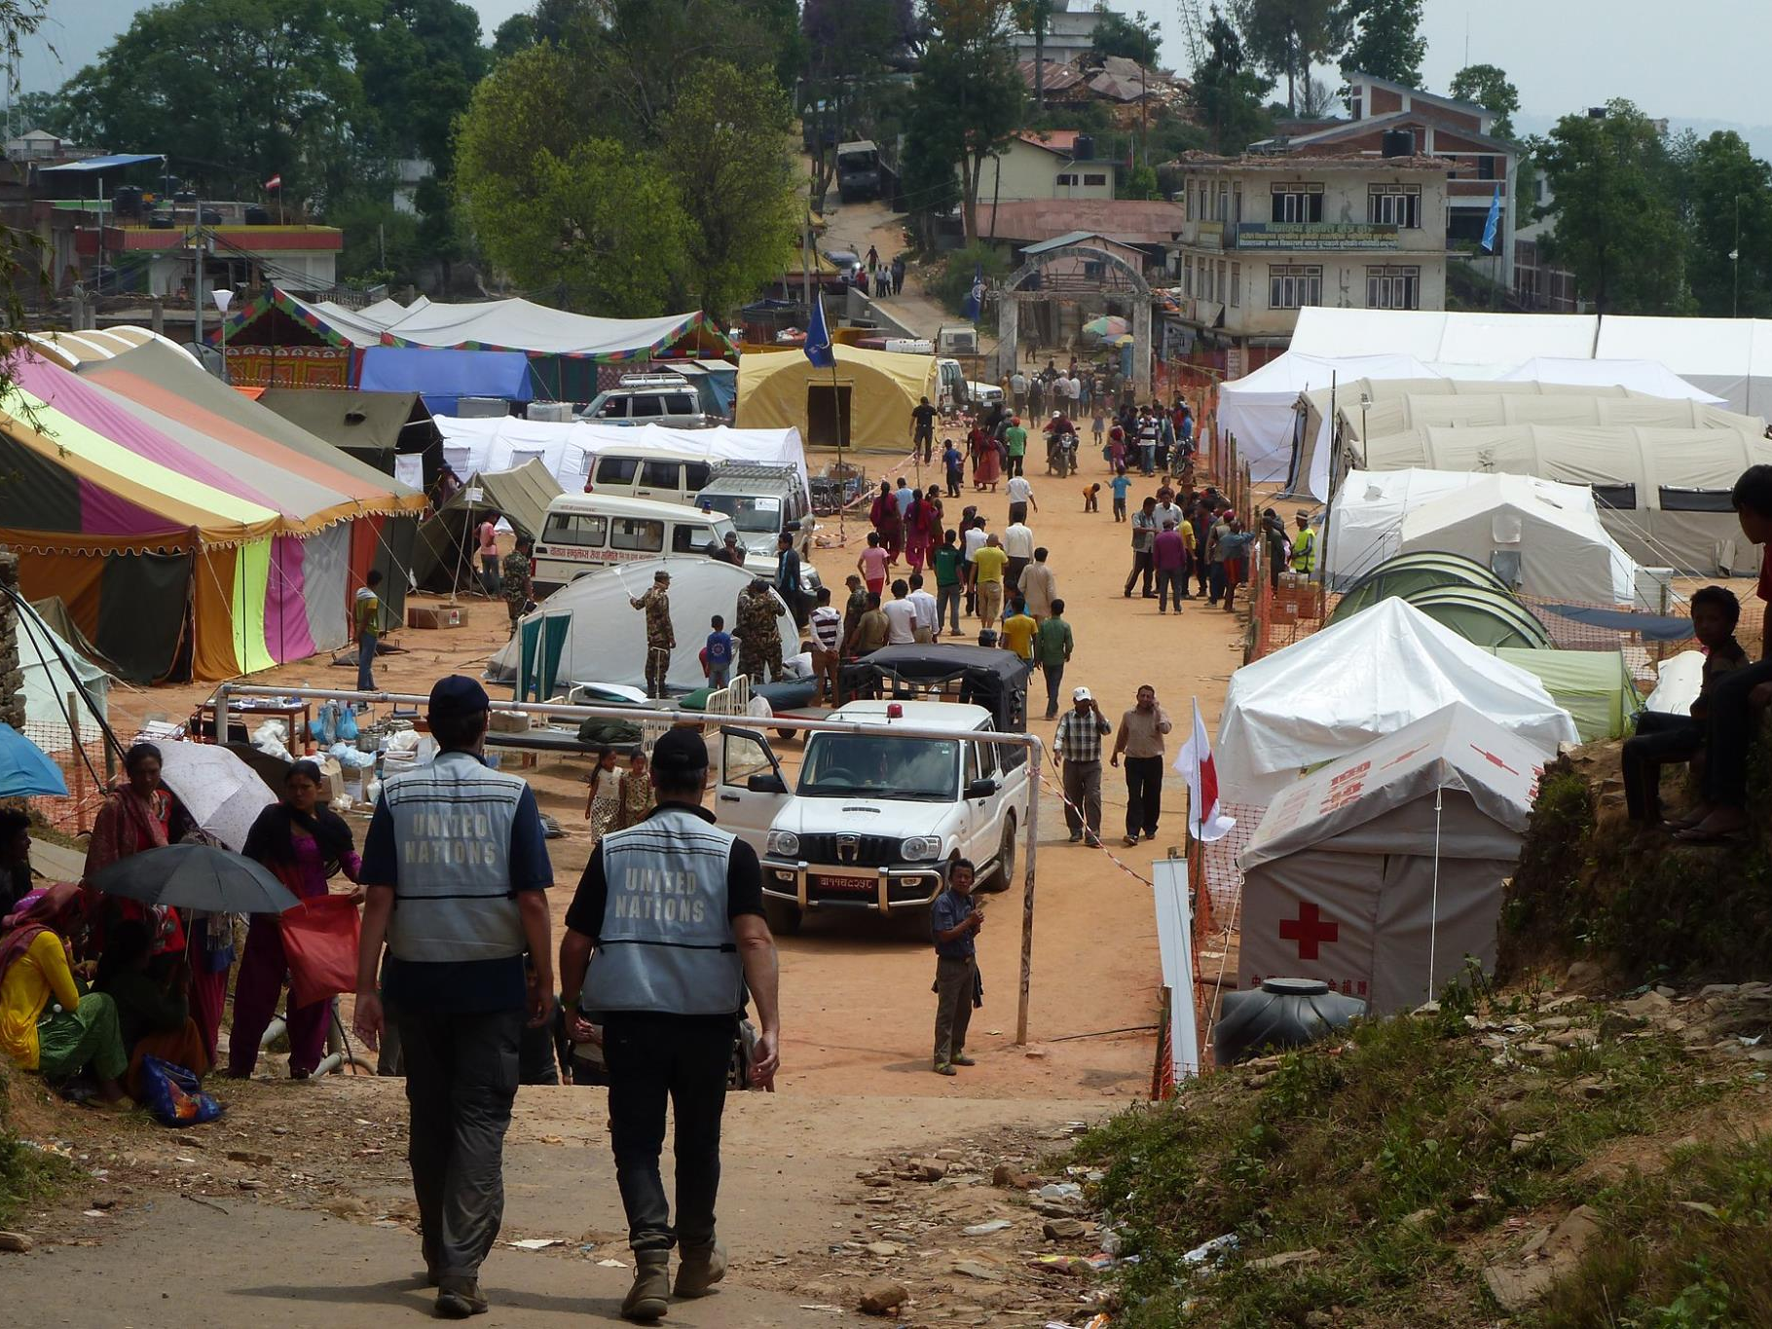
Notes:
UNDAC
UN Disaster Assessment and Coordination (UNDAC) teams are standby teams of specially-trained international disaster management professionals from UN Member States, UN agencies and other disaster response organizations that can be deployed within 12 to 48 hours of a disaster.
The primary elements of the UNDAC mandate are assessment, coordination and information management.
An UNDAC team normally stays in the affected area for the initial response phase, which can be up to three weeks.

Slide 4
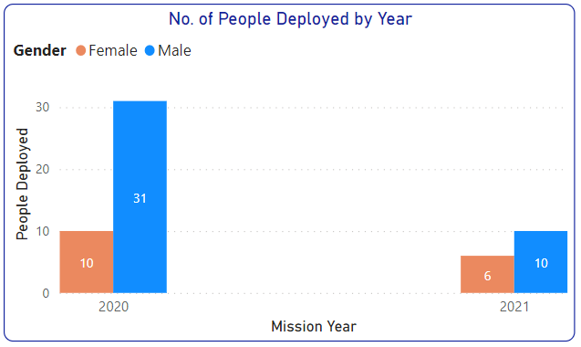
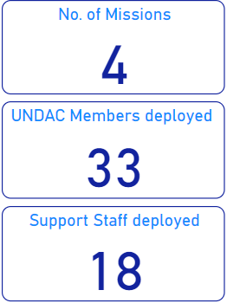
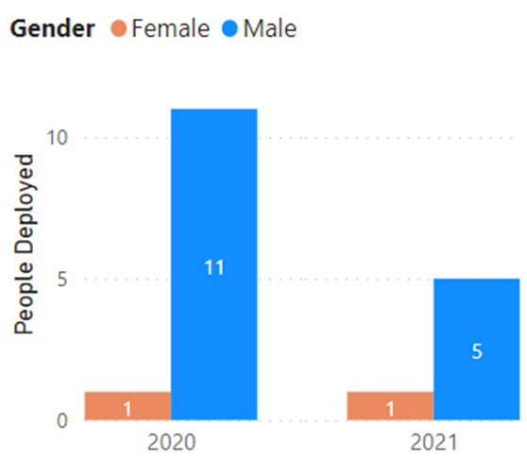
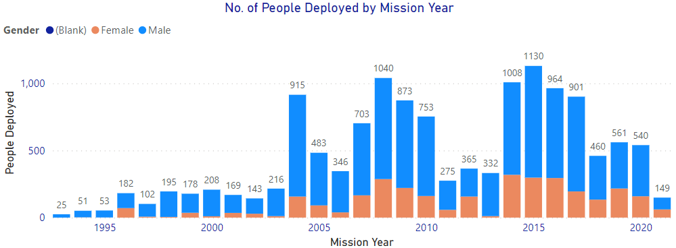
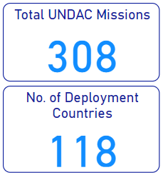
Mission statistics
Support staff
Notes:
In 2020, reflecting the covid19 situation, remote team concept was developed. The remote support available especially in the areas of IM and assessment.
In case of physical deployment, the pandemic measures are strengthened.

Slide 5
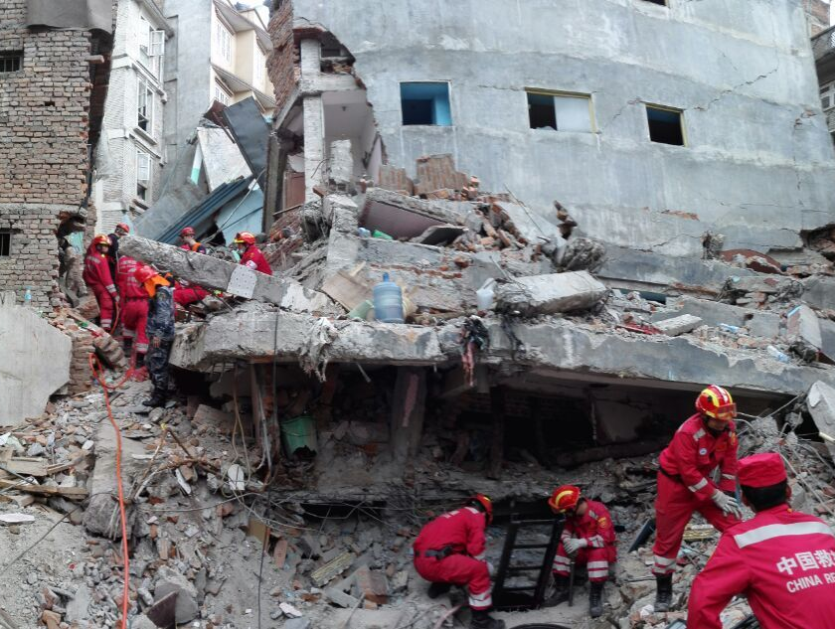
Notes:
INSARAG
USAR are composed of trained experts who provide rescue and rescue assistance in an emergency.
They can be operational within 24 to 48 hours of a disaster.
USAR teams are offered and received bilaterally and/or with the coordination support of the OCHA-managed International Search and Rescue Advisory Group (INSARAG).
Part of INSARAG is the classification system which ensures that teams that are deploying a meeting a global standard both in their technical skills and their ability to deploy quickly and self-sufficiently. It also means Government know what teams precise capacities and capabilities are.

Slide 6
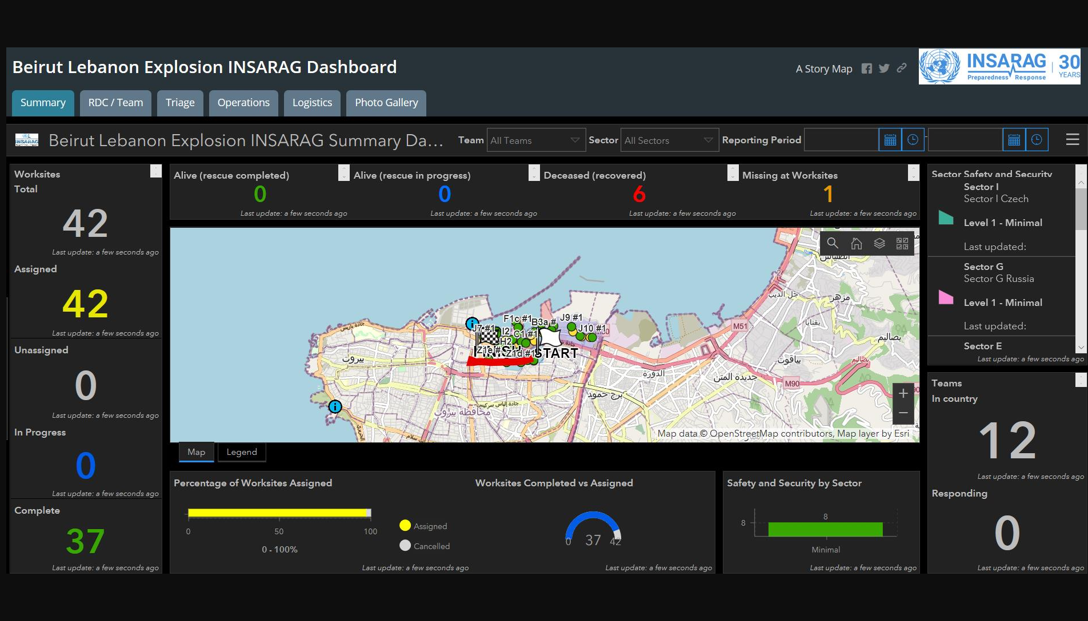
Notes:
ICMS: new INSARAG information management tool using ESRI, funded by INSARAG network
It was activated during Beirut response in 2020. It helped immediate information sharing among INSARAG and OSOCC including potential hazard and collapsed building status. Those information was useful identifying further humanitarian response (assessment of historic buildings for possible restoration/demolishment, environmental risk assessment, etc.)

Slide 7
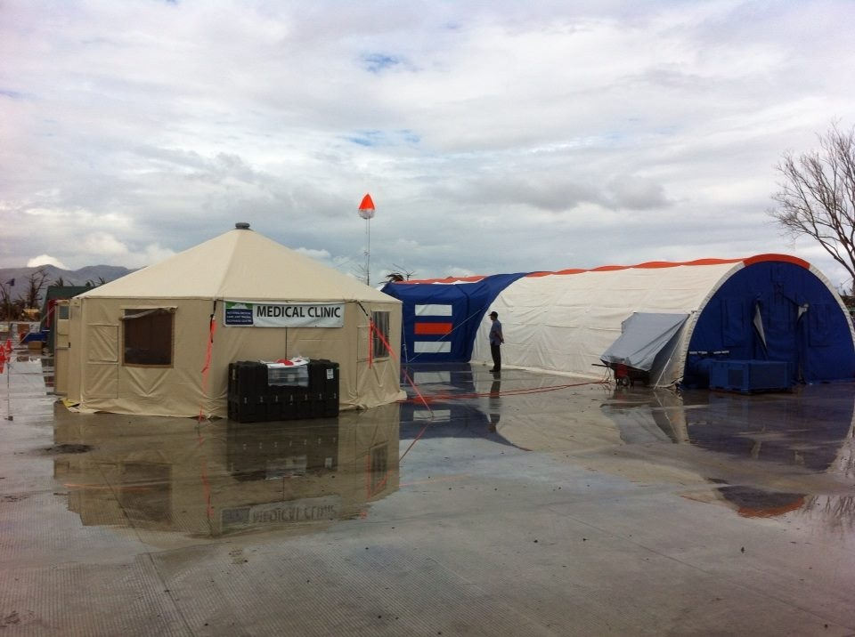
Notes:
EMTs
Emergency Medical Teams (EMTs) refers to a group of health professional providing direct clinical care to populations affected by outbreaks and emergencies as surge capacity in supporting the local health system. An EMT includes governmental (both civilian and military) and non-governmental personnel and can be comprised of both national and international staff.
The WHO Emergency Medical Teams (EMT) Initiative assists organizations and member states to build capacity and strengthen health systems by coordinating the deployment of quality assured medical teams in emergencies.
WHO has developed a global verification system where EMTs can be classified and ready to be deployed to health emergencies. A global list of all EMTs that meet the WHO EMT minimum standards for deployment provides time-limited surge clinical capacity to the affected populations. It allows a country affected by a disaster or other emergency to call on teams that have been classified and quality assured.

Slide 8
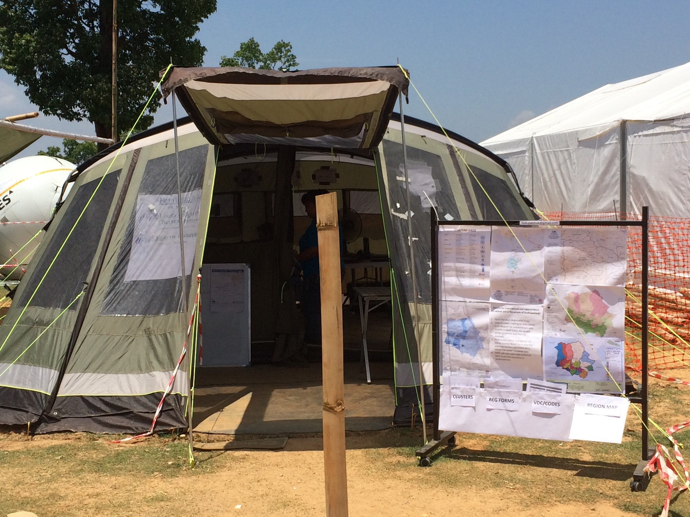
Notes:
OSOCC
On-Site Operations Coordination Center (OSOCC) provides a common platform for the coordination of international response efforts and services as the centre of the OSOCC system.
It is simultaneously a place and a methodology, similar to a national government’s Emergency Operations Centre but with an approach applicable to its function within the international humanitarian system.
It includes components such as the Reception and Departure Centre (RDC) which supports coordination at international points of entry into an affected country, sub-OSOCCs that can support coordination in different parts of the affected country (if across a large areas for example) as well as specialized cells that support parts of response, such as the USAR Coordination Cell, EMT Coordination Cell, Humanitarian Civil Military Coordination Concept (HuMOCC).

Slide 9
ASEAN-UN Interoperability
United Nations
Association of South East Asian Nations
GA Resolutions
AADMER
Emergency Relief Coordinator
ASEAN Hum Asst Coord (ASEAN SG)
OCHA
AHA Centre
ERP for High-Risk Countries
ASEAN Joint Disaster Response Plan
ERAT
UNDAC
ERAT
OSOCC
JOCCA
JOCCA

Slide 10
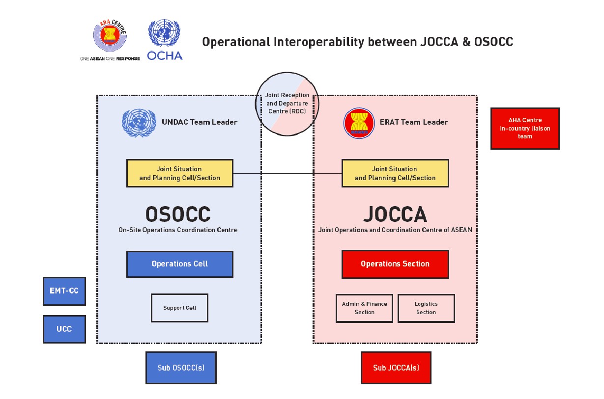

Slide 11
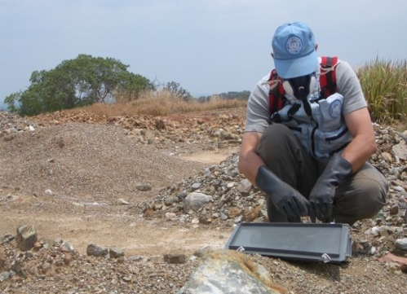
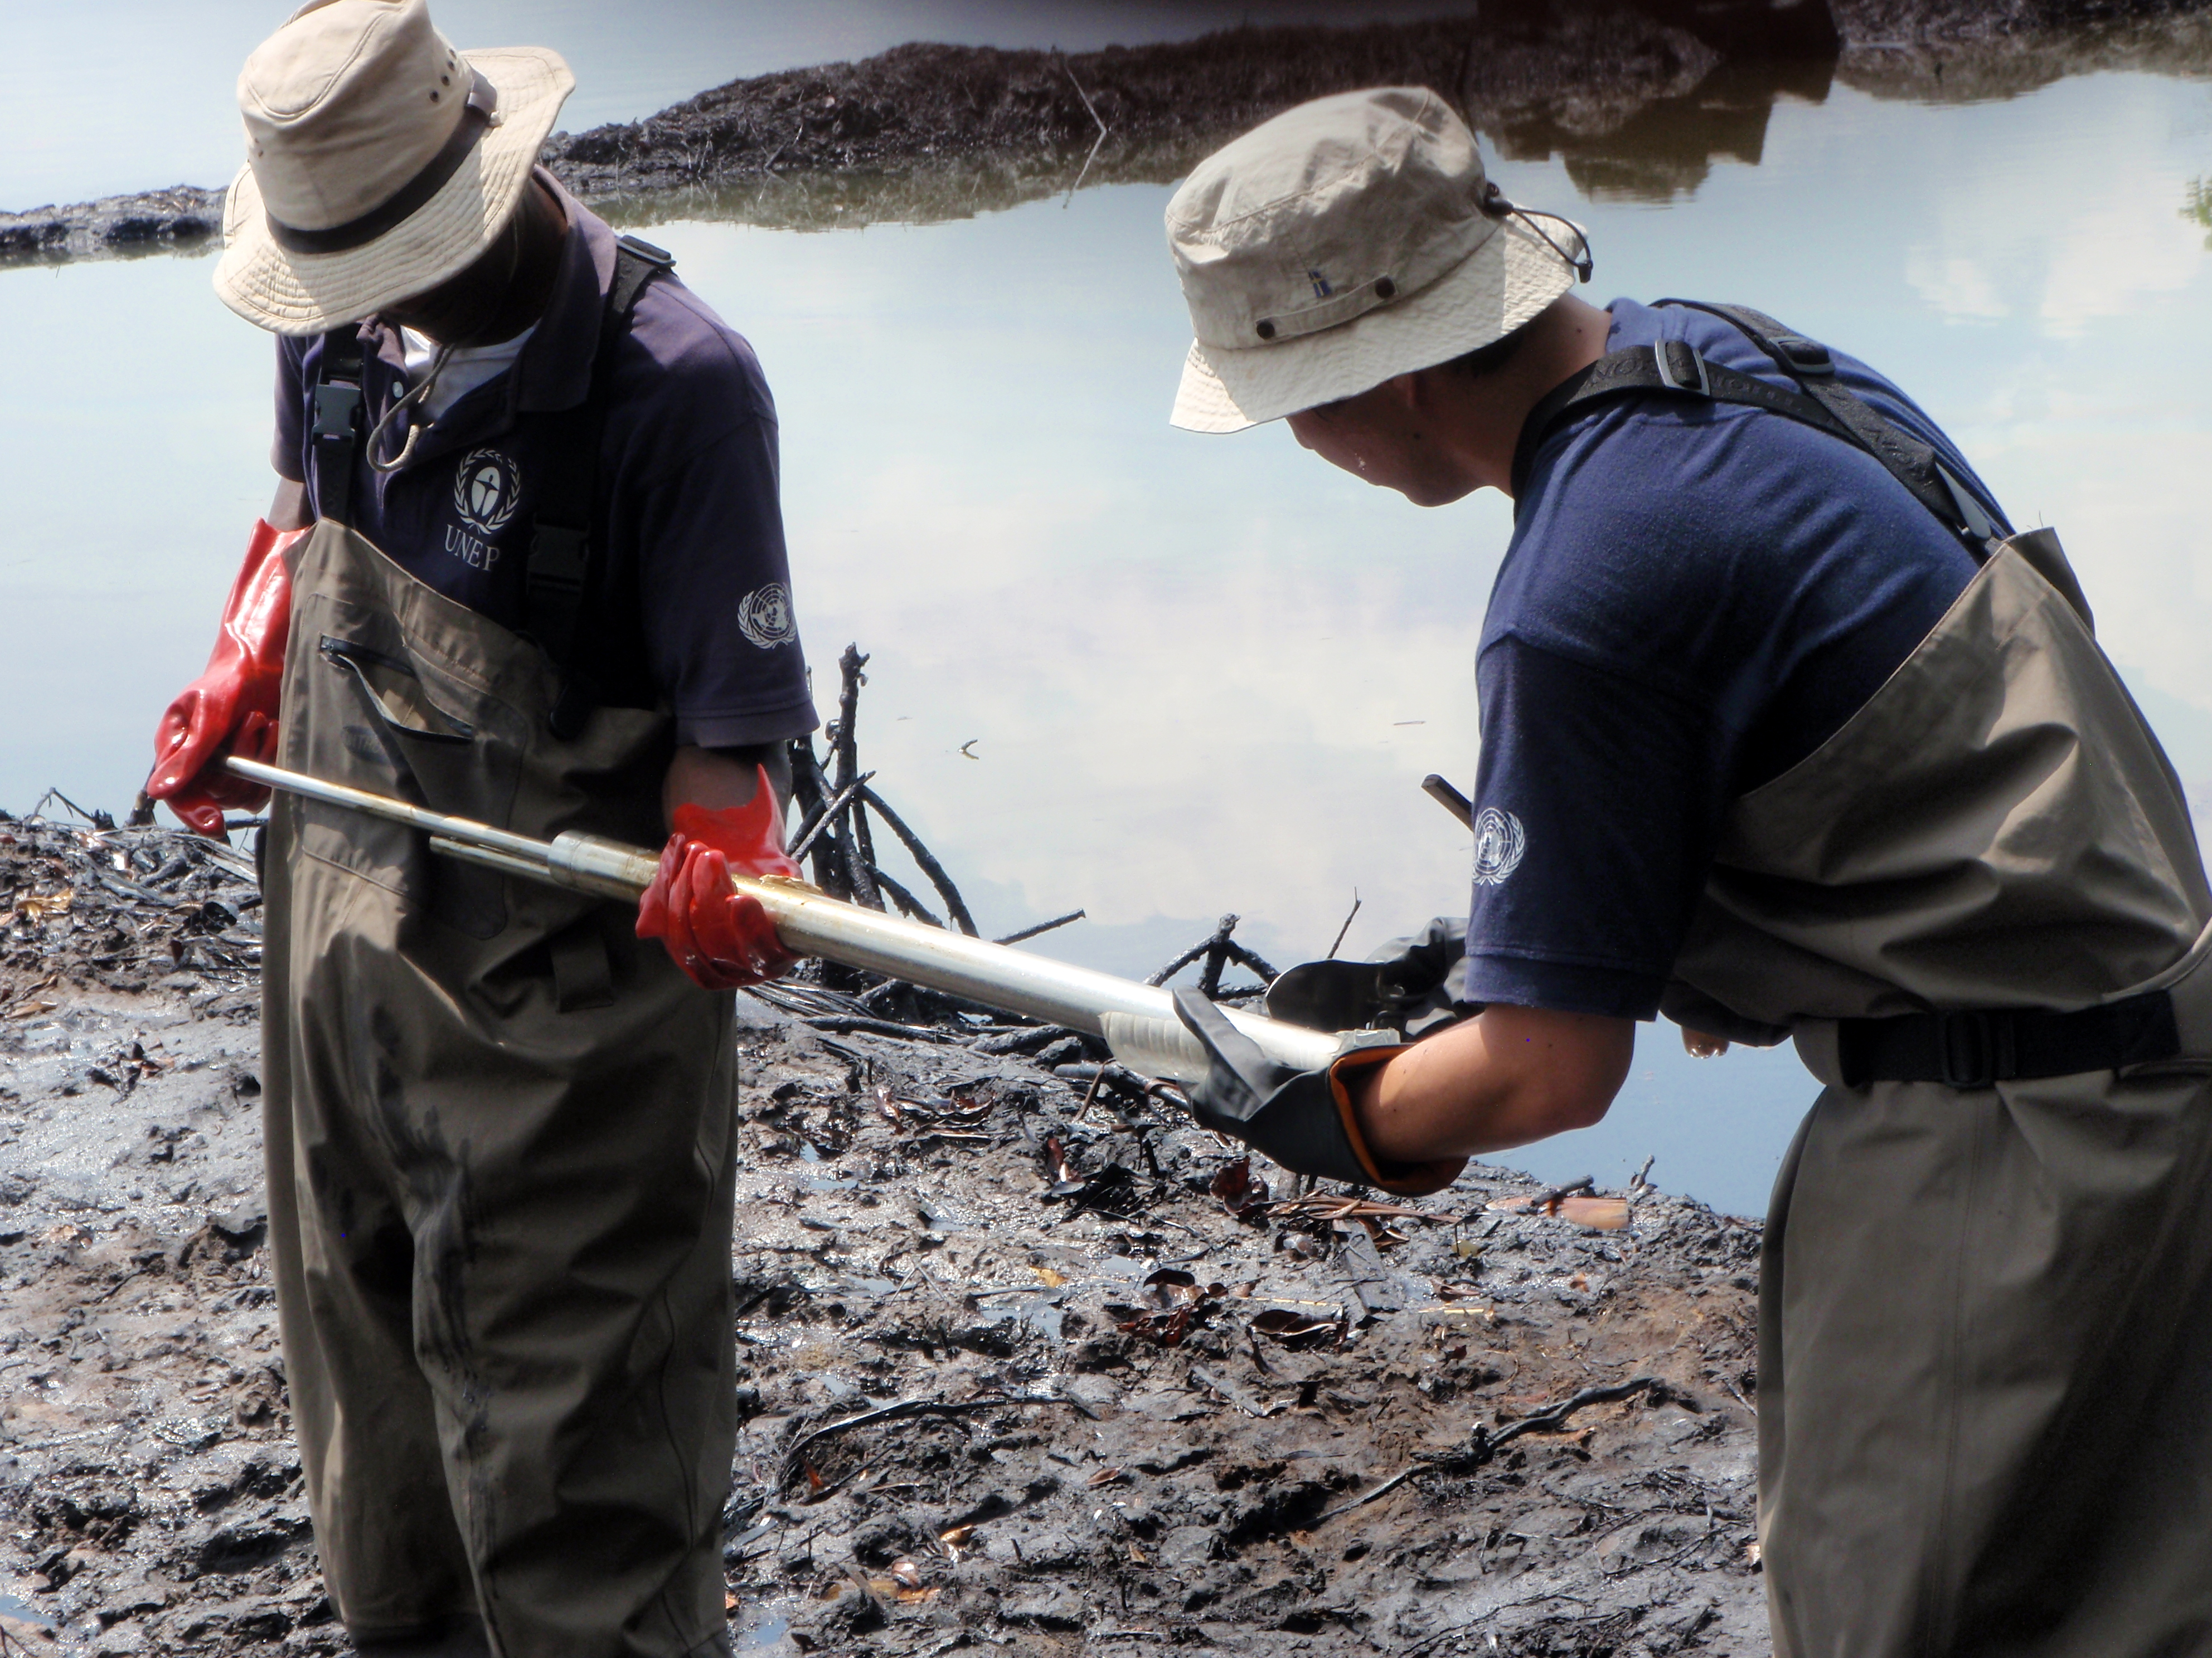
Notes:
UNEP/OCHA Joint Environment Unit was founded in 1994 at request of UN Member States as Global mechanism to respond to environmental dimensions of emergencies
Environmental expertise include chemical contamination, dam, environmental assessment, soil/water contamination, HazMat, Hydrocarbon Contamination, Geologist.
Response support available also remotely: Remote Environmental A&A Cell will be activated to conduct remote assessment of environmental hazards. Recent example is the rick of potential affected population in case of dam burge during the cyclone response in Guatemala, and Air Pollution in Colombia caused by waste fire in Venezuela (picture)
It has become a common practice from 2020 that Environmental Experts will be embedded to all UNDAC deployment.

Slide 12
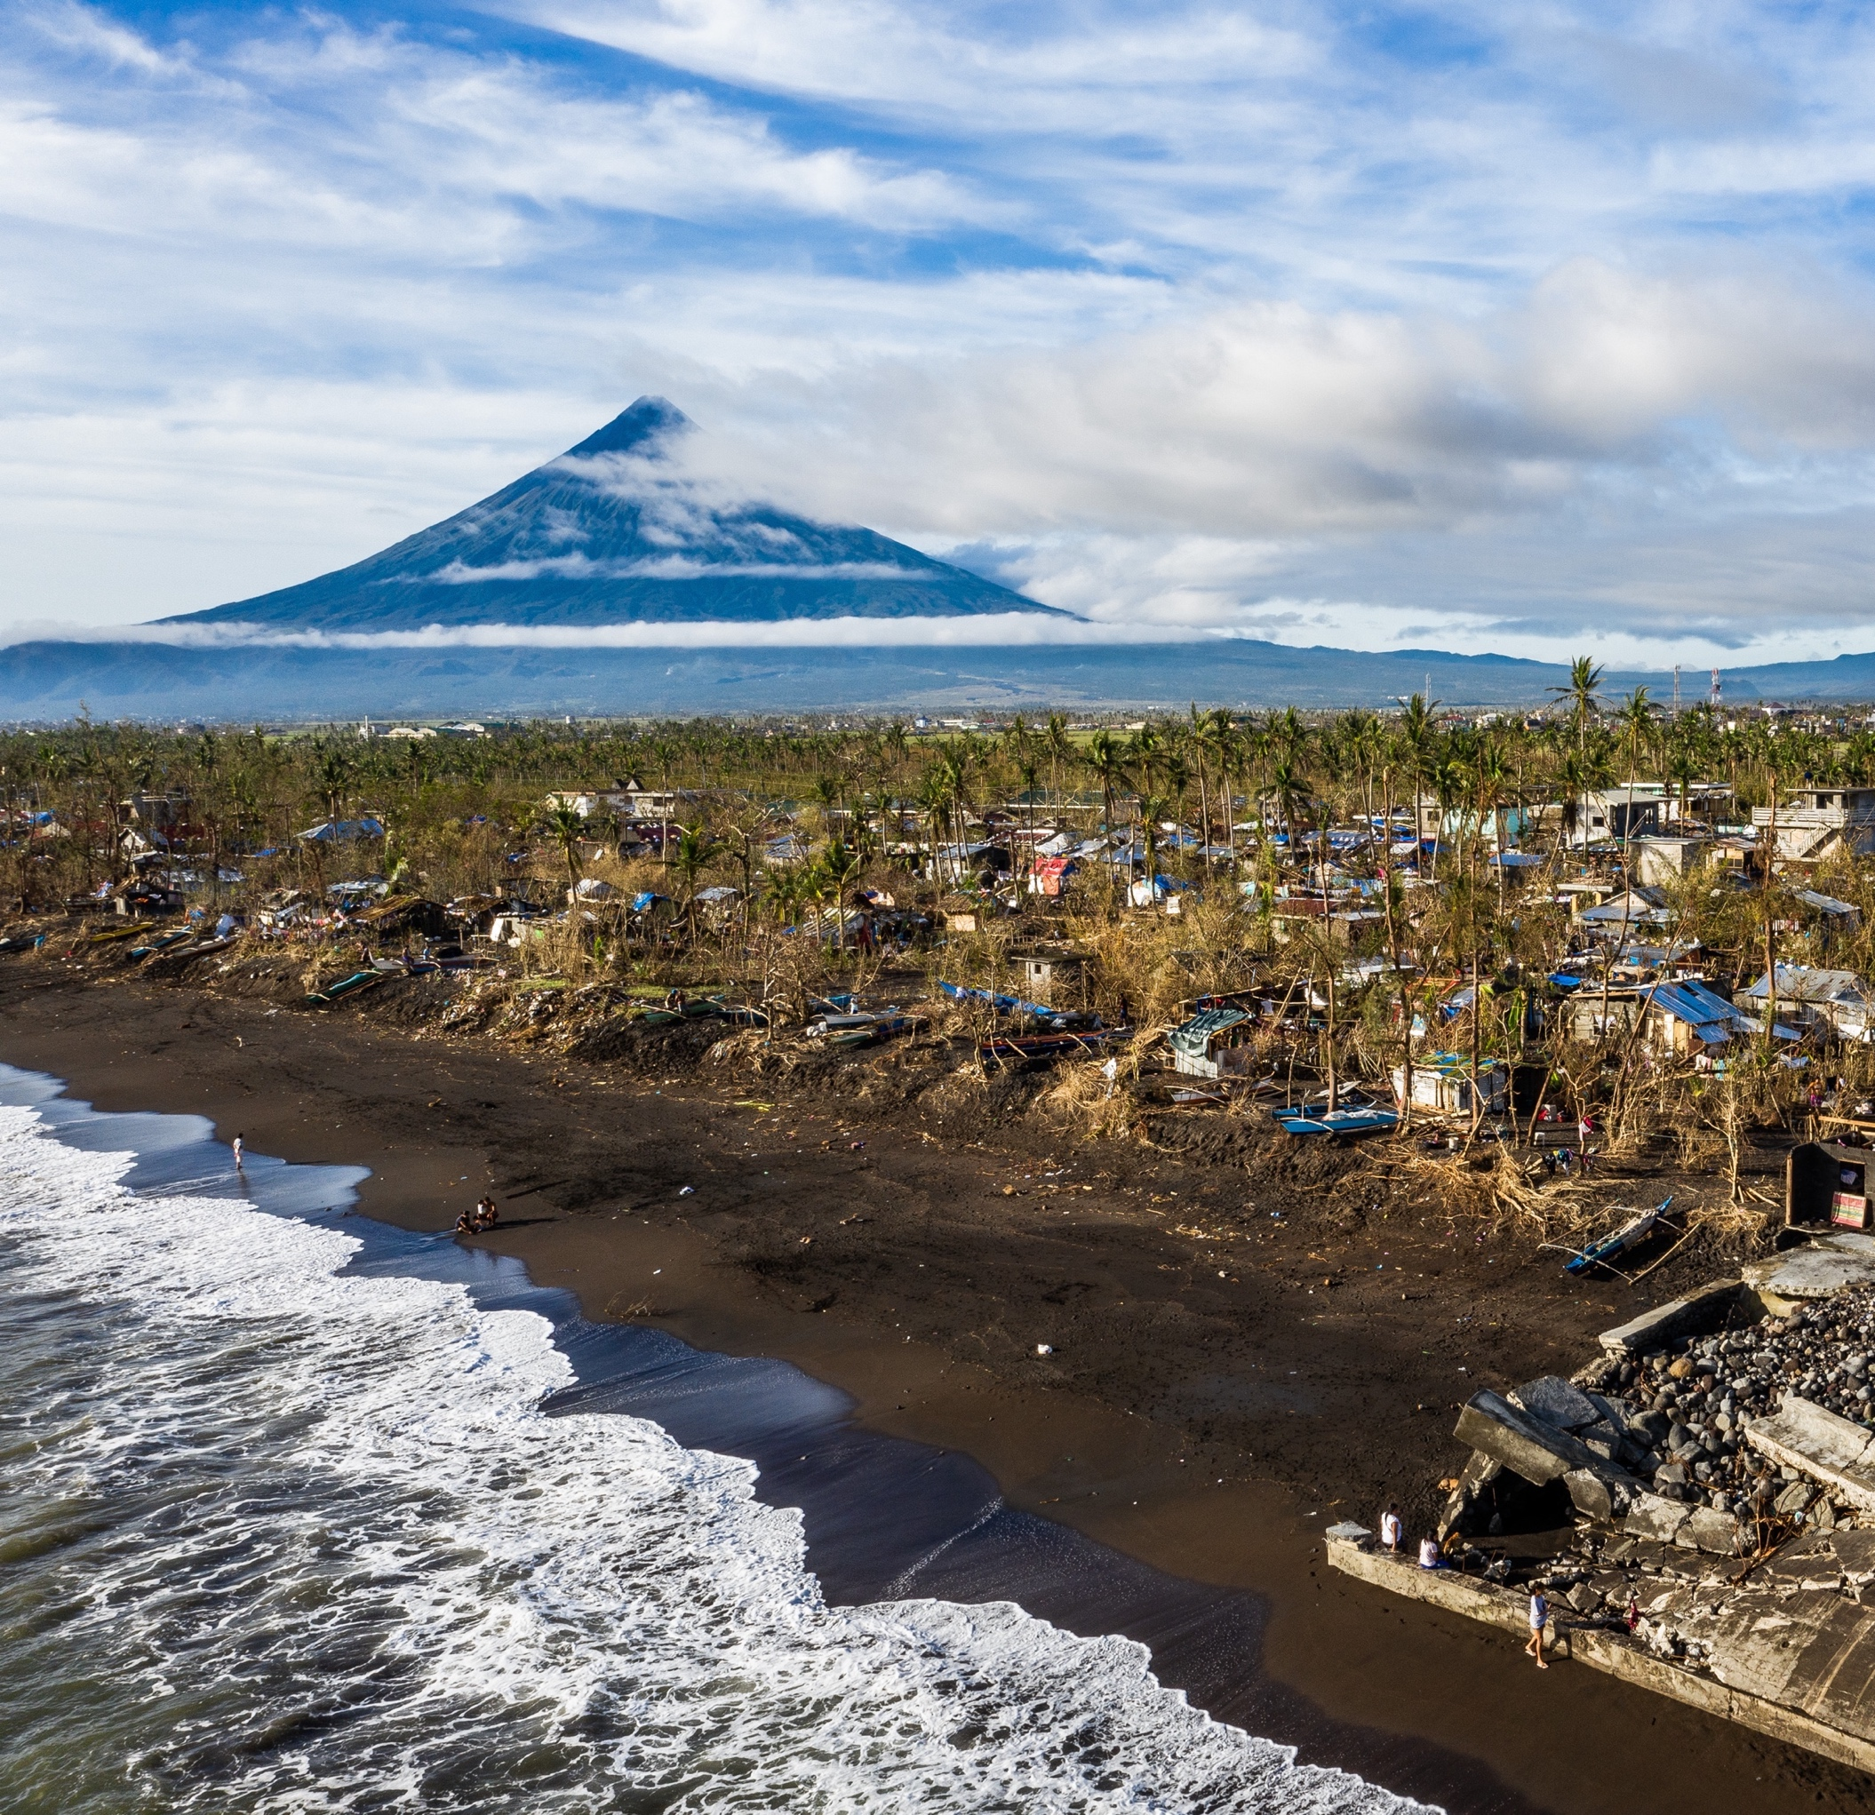
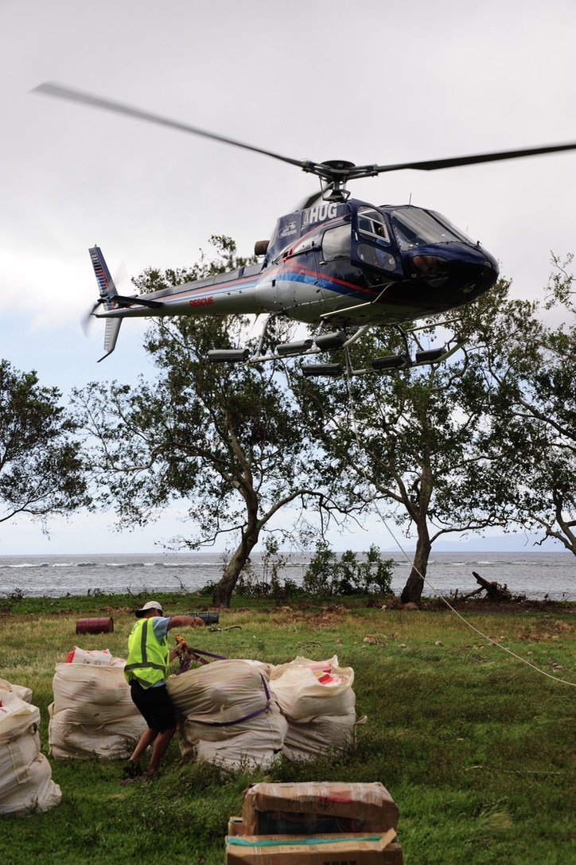

Notes:
Connecting Business Initiative (CBI): 17 business networks were engaged and supported by the CBi Secretariat globally. In ASEAN, PDRF in the Philippines is part of the network and provide support during emergencies and covid.
Coordinating with private sector is one of the key and emphasis made as localized response, particularly during the pandemic where immediate international assistance are difficult to reach due to government restriction.
2 networks are being established in Viet Nam and Indonesia

Slide 13
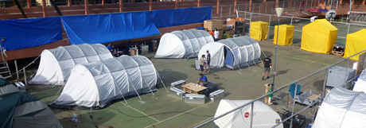
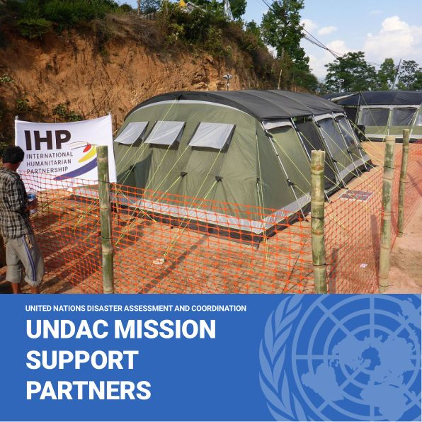
Notes:
IHP
International Humanitarian Partnership (IHP) is informal networks of governmental organisations working in support of emergency operations on a daily basis.
IHP, which is a partnership between governmental organizations from Denmark, Estonia, Finland, Germany, Norway, Sweden and UK, has a strong capacity to support the United Nations, the European Union and other international organisations. APHP, with participating governmental organisations from Australia, China, Japan, New Zealand, Singapore and South Korea is a regionally based model primarily to support UN agencies and UNDAC teams, as well as the IFRC and ASEAN.
These partnerships can provide a standardised modules - from small Information Communication Technology (ICT) modules and Information Management (IM), to large base camps and humanitarian compounds

Slide 14
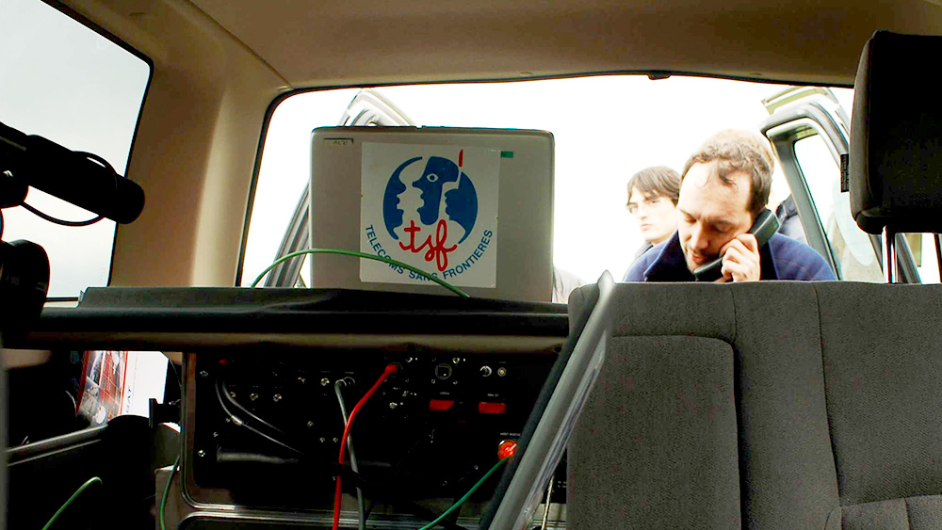
Notes:
Telecoms Sans Frontier
Télécoms Sans Frontières can provide support to UNDAC and ERAT teams in telecommunications in response.

Slide 15
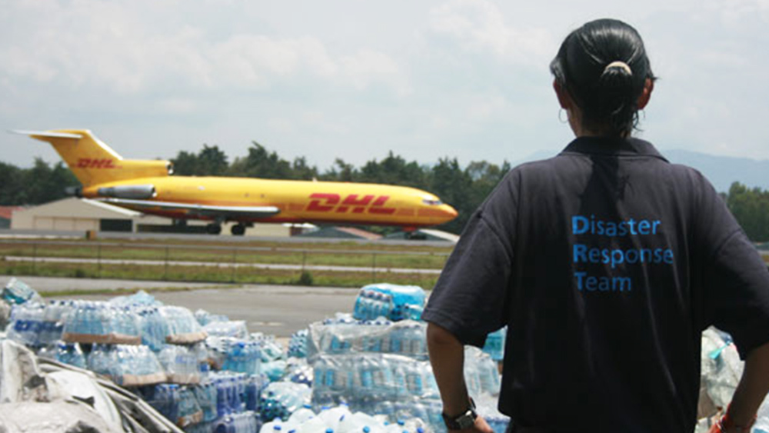
Notes:
DHL
DHL can support with airport logistics and other logistics support during a response and often have good relationships with airport authorities.

Slide 16
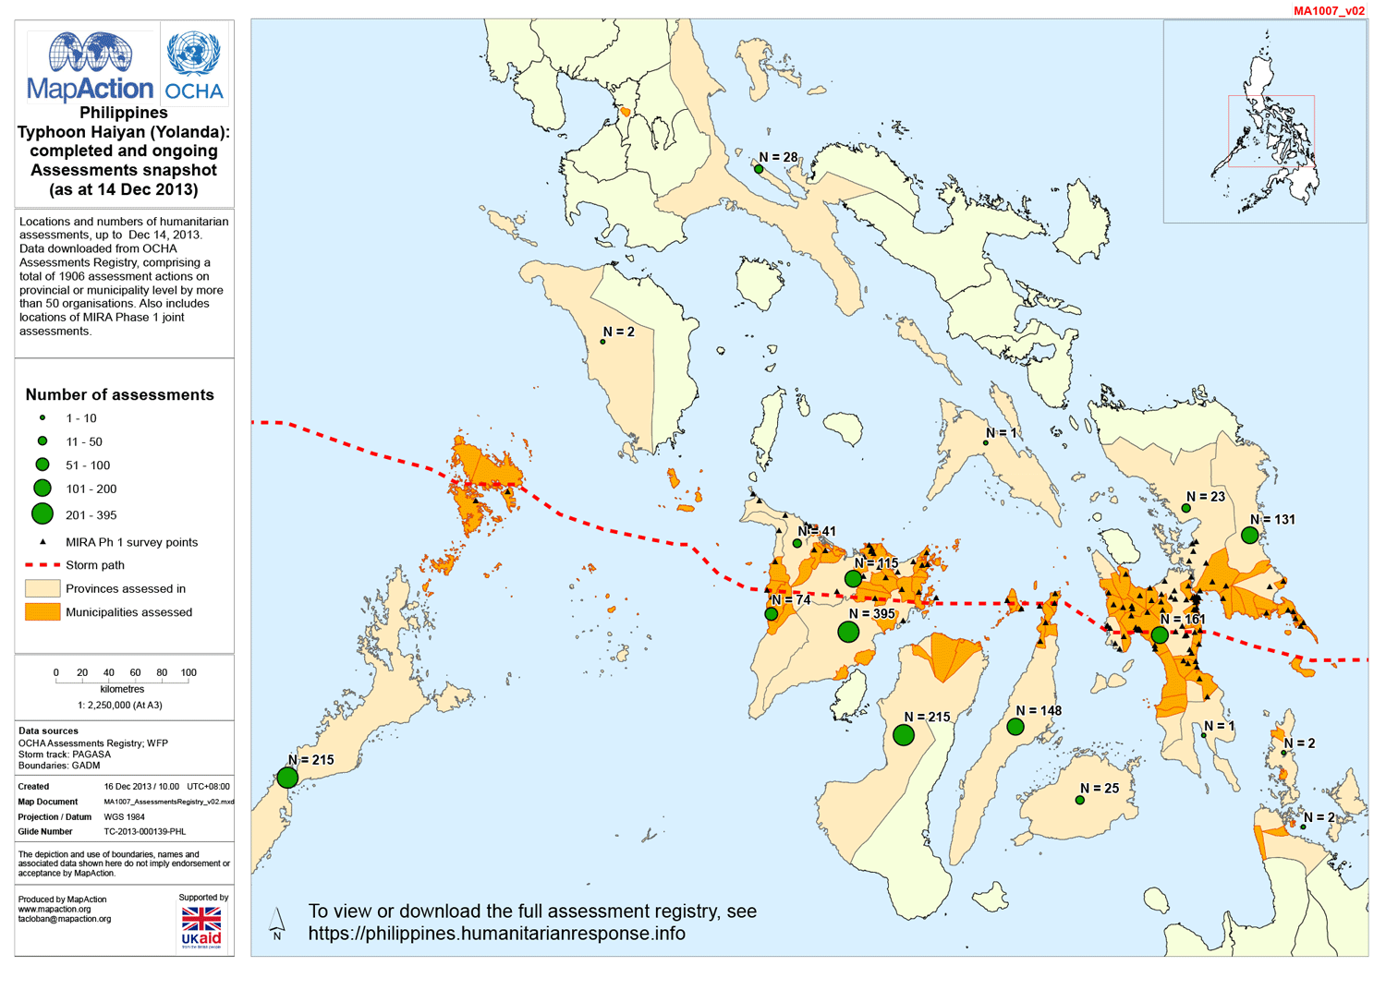
Notes:
MapAction
MapAction can provide support to UNDAC and ERAT teams in information management and particularly in mapping and can assist in visualizing information for planning and response.

Slide 17
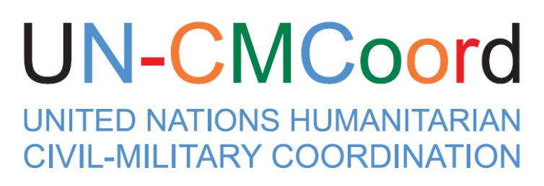
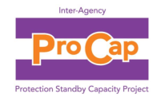





SURGE CAPACITY
Notes:
Surge Capacity
There are a range of standby mechanisms that can be called upon in various technical areas to provide advisory and or coordination support.
These subject matter experts are usually deployed free of charge upon request of the HC and/or OCHA.

Slide 18
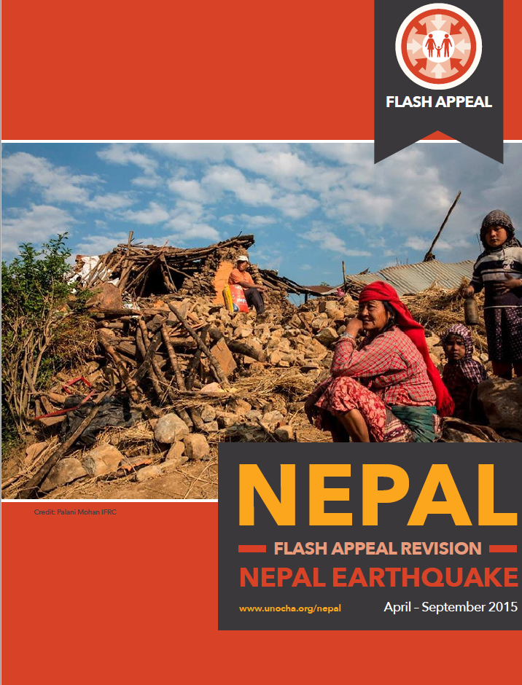
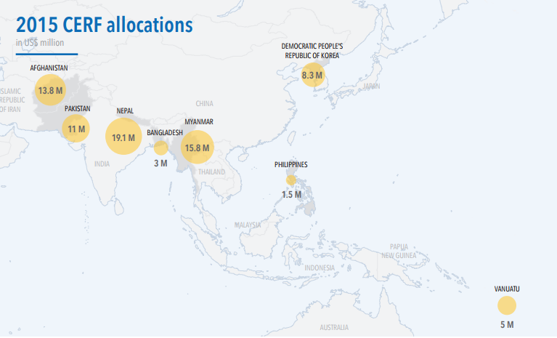

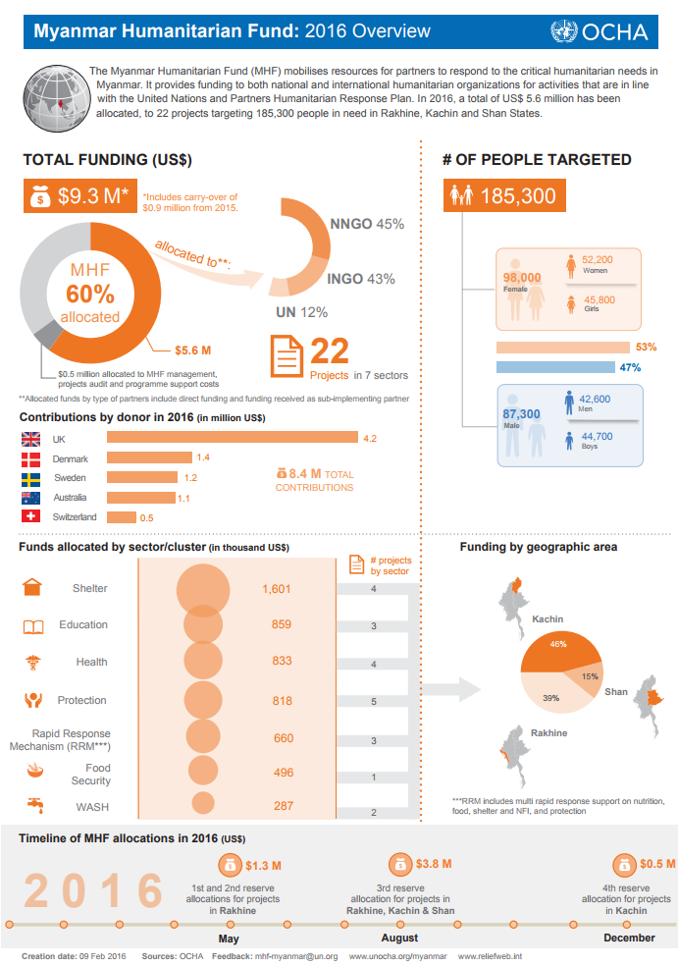
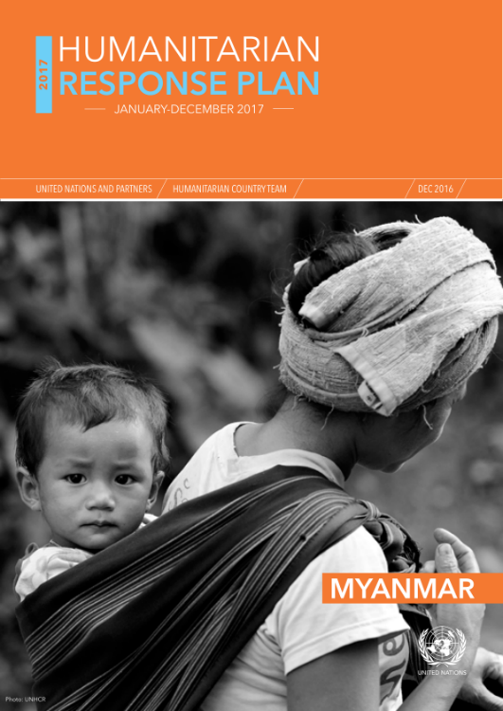
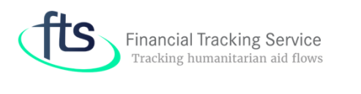
Notes:
Funding
There are a range of ways to mobilise or access funds during a response, although most of these here are available for the international humanitarian system, particularly UN agencies and International NGOs but national NGOs also be eligible.
There is also a platform that tracking humanitarian aid flows to the different emergencies globally.

Slide 19
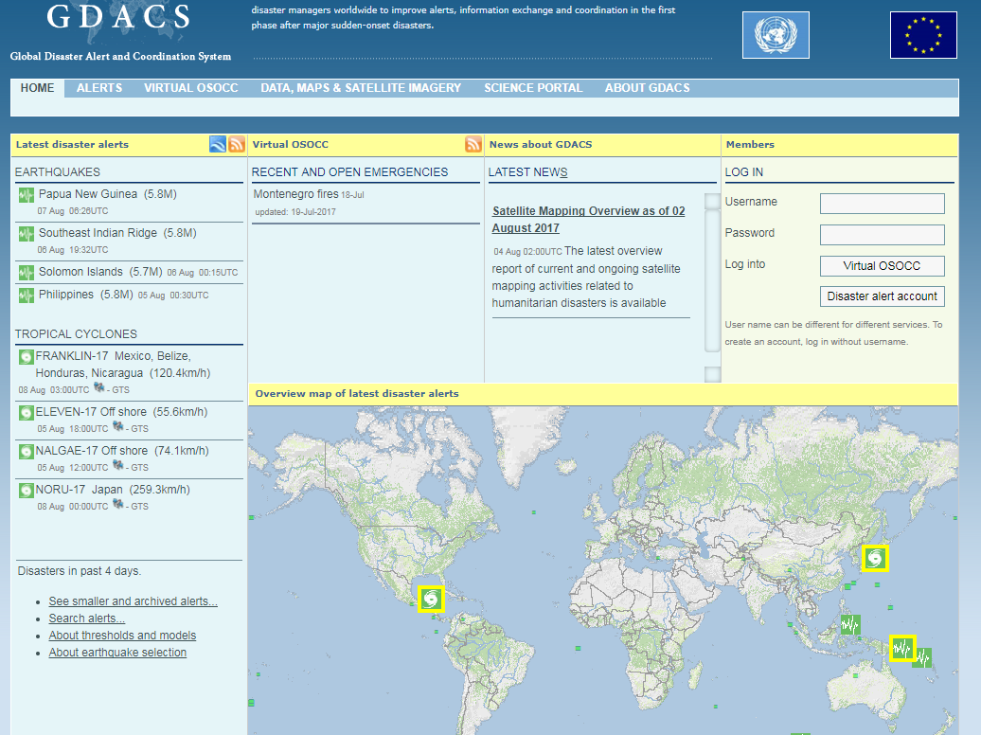
Notes:
GDACS / V-OSOCC
GDACS is a online platform that provides information on disasters.
It also hosts the V-OSOCC portal that provides an online network and information portal that facilitates data exchange between disaster responders and the affected countries.
It is the first place where technical teams such as USAR and EMT will register their ability to deploy.

Slide 20
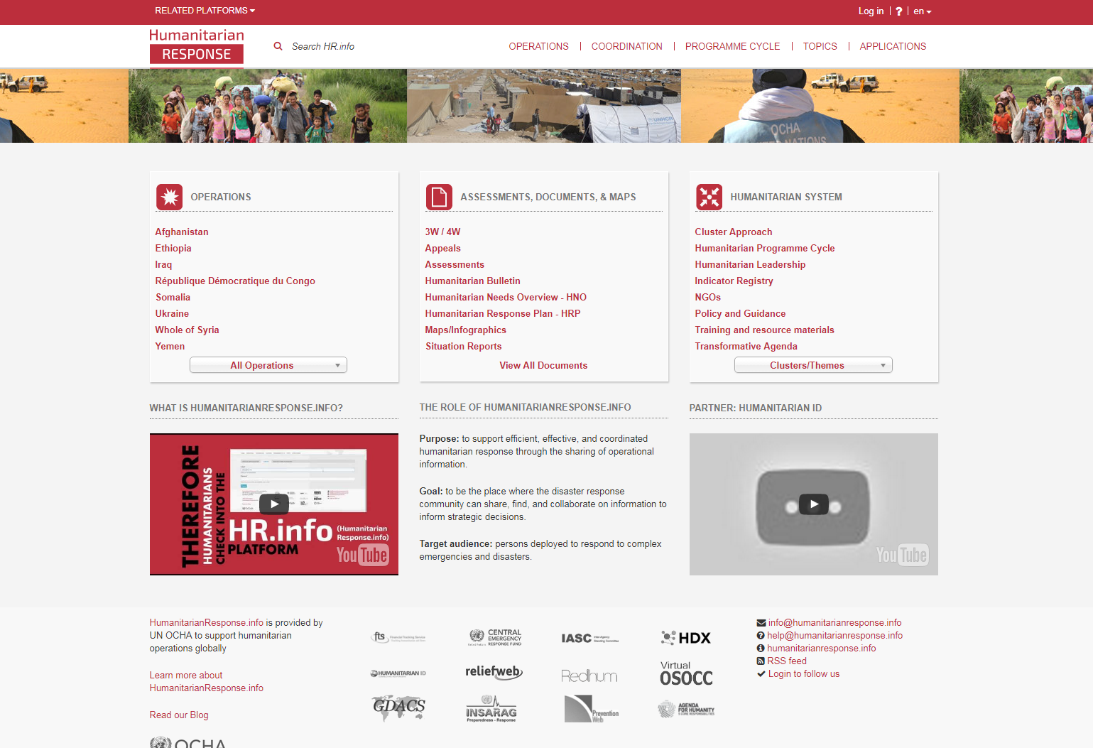
Notes:
HR.info
HR.info is a humanitarian web-based platform to support inter-cluster coordination and information management. The main website provides core features, tools, guidance etc. for all countries but also hosts country-specific sites including information on clusters, meetings, key documents, meetings etc.

Slide 21
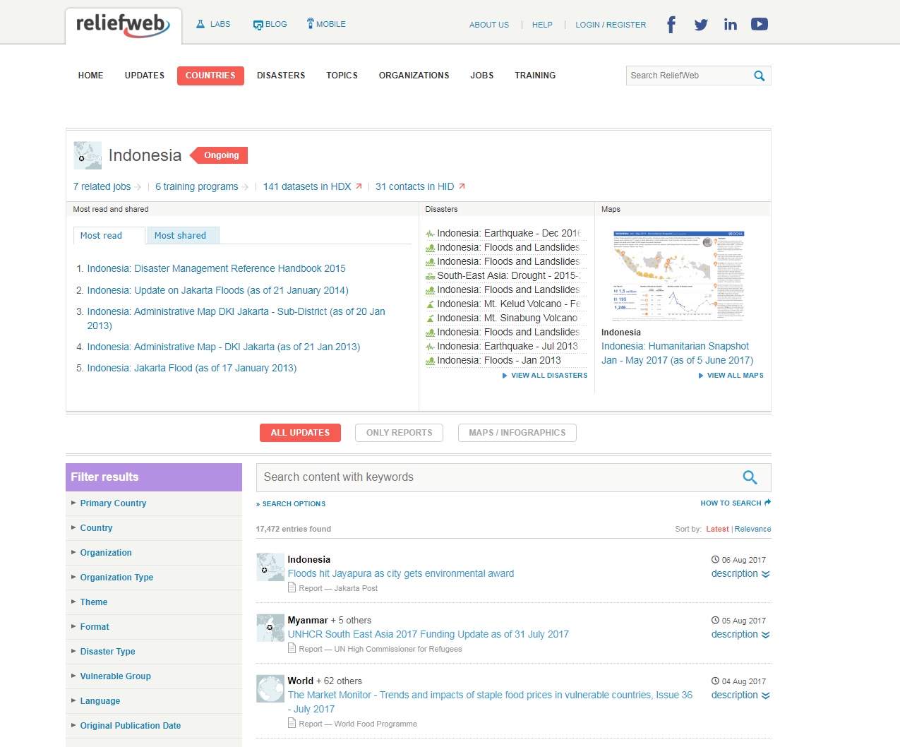
Notes:
ReliefWeb
RW is a humanitarian website managed by OCHA that provides timely, reliable and relevant information and analysis on emergencies and disasters.
It offers a consolidated collection of information from trusted sources, including government, UN, NGOs, civil society etc.

Slide 22
Key messages
There are multiple tools and services at both the regional and international level that can be called upon to support both Governments, international and national organisations and affected people in response.
These tools and services are different in what support they can provide and the processes that activate them.
Information on these tools and services, what they are for, who they are for and how they can be called up is in the Asia Pacific Guide for Governments.

