Slide 1

ASEAN
Image source: https://seekingalpha.com/article/3972532-is-asean-economic-community-doomed-to-fail

Slide 2

Some Principles
ASEAN Organs
Respect for independence, sovereignty, equality, territorial integrity and national identity of all ASEAN Member States
Commitment to regional peace, security and prosperity
Non-interference in the internal affairs of AMS
Respect for fundamental freedoms, the promotion and protection of human rights, and the promotion of social justice
Unity in diversity
ASEAN Centrality
Consensus-based
ASEAN Summit
ASEAN Coordinating Council (ACC)
ASEAN Community Coordinating Council
ASEAN Sectoral Ministerial Meeting Bodies
Secretary General of ASEAN
ASEAN Secretariat
Committee of Permanent Representatives to ASEAN
ASEAN National Secretariats
ASEAN Human Rights Body
ASEAN Foundation

Slide 3
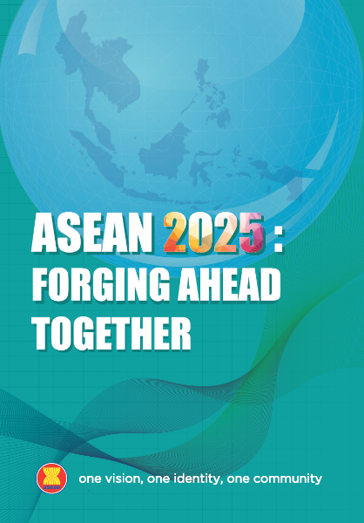

ASEAN COMMUNITY PILLARS
ASEAN POLITICAL-SECURITY COMMUNITY
(APSC)
ASEAN
ECONOMIC COMMUNITY
(AEC)
ASEAN
SOCIO-CULTURAL COMMUNITY
(ASCC)
Our ASEAN Socio-Cultural Community by 2025 shall be one that engages and
benefits the peoples, and is inclusive, sustainable, resilient, and dynamic.

Slide 4
Disaster Management in ASEAN Architecture
ASEAN Summit
ASEAN Coordinating Council
ASEAN Community
Coordinating Council
ASEAN Sectoral Ministerial
Meeting Bodies
Committee of Permanent Representatives to ASEAN
Secretary General of ASEAN
ASEAN Secretariat
ASEAN National Secretariats
ASEAN Human Rights Body
ASEAN Foundation
ASEAN Summit
ASEAN Socio-Cultural Community
ASEAN Ministerial Meeting on
Disaster Management (AMMDM)
AADMER Conference
of Parties (COP)
ASEAN Committee on
Disaster Management (ACDM)
Governing Board of the
AHA Centre
ASEC Division on Disaster
Management and Humanitarian
Affairs (DMHA)
ASEAN Coordinating
Centre for Humanitarian
Assistance on disaster
management

Slide 5























ASEAN Disaster Management
ASEAN Leaders (Summit & Ministerial Meetings)
ASEAN Committee on Disaster Management |
The AHA Centre as the main regional coordinating agency
Secretary General of ASEAN as Humanitarian Assistance Coordinator | SG-AHAC
In the event of large-scale natural disasters, the Secretary-General of ASEAN as ASEAN Humanitarian Assistance Coordinator and the AHA Centre will establish coordination lines

Slide 6
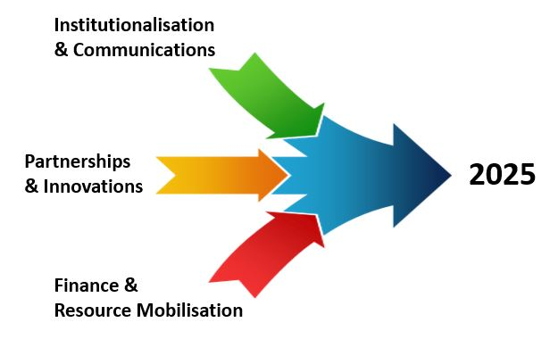
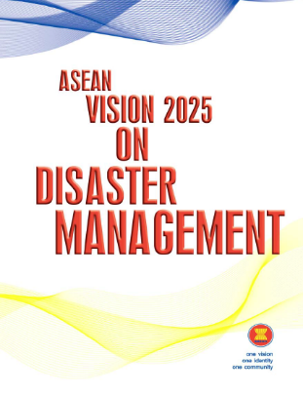
With the region that is prone to disasters and global initiatives are taking place, ASEAN will need to anticipate the next decade and shape the future of disaster management both regionally and globally
On becoming
a global leader on disaster management

Slide 7
By 2025 | Institutionalisation and Communication
The AHA Centre
Expand the current scope and focus of the AHA Centre as AADMER recognises both natural and human-induced disasters
Build holistic and cross-sectoral governance approach in institutionalising AADMER across the three ASEAN pillars driving the integration of the ASEAN Socio-Cultural Community, ASEAN Economic Community and ASEAN Political Security Community on disaster management and emergency response
Three ASEAN Pillars
Ensure strategic engagement of the Secretary-General of ASEAN as the ASEAN Humanitarian Assistance Coordinator to communicate the transformative agenda in disaster management and champion disaster risk reduction and climate change adaptation
Secretary-General of ASEAN
Develop an integrated and comprehensive communications master plan for disaster management that allows for accurate and timely communication, informs the public what ASEAN is doing for the disaster-affected population, enhances ASEAN’s visibility in the region, and positions ASEAN as the pioneer in this area
Integrated Communication
Position ASEAN as a pioneer in transforming disaster management landscape in the Southeast Asian region and beyond, through partnership with global institutions and other intergovernmental and regional organisations
Global Partnership

Slide 8
By 2025 | Partnership and Innovation
Establish network and innovative partnership with non-traditional actors such as private sector to introduce change to humanitarian landscape and innovative ways to manage and respond to disasters by leveraging their capabilities, expertise, knowledge, research and development, innovation and network
Partnership for innovation
Partner and empower ASEAN home-grown non-government organisations empahising on the importance of drawing on the local knowledge and capacity of civil society organisations understanding that local civil society organisations have the ability to respond faster, tap local networks, and understand the local contexts to realise the vision of a people-oriented, people-centred ASEAN
Local Network and local knowledge
Establish a series of awards recognising significant innovations that lead to change in disaster management and emergency response in the region, particularly recognising the public, private and people sectors and notably young people and small start-up businesses
Innovation for Change
Invest in human capital to build professionalism in disaster management through standardisation and certification as well as establishment of a network of ASEAN centres for training and leadership in ASEAN which will enable the region to serve as a role model on disaster management and emergency response globally
Human Capital
Form ASEAN think-tank on disaster management and emergency response in partnership with educational institutions, foundations, think-tanks and policy research organisations/institutions, private sector to provide thought leadership and strategic policy inputs for the region as well as contribute to shape global policies and strategies
Regional Think-Tank

Slide 9
By 2025 | Finance and Resource Mobilisation
Transform the way AADMER and the AHA Centre are funded in the next ten years
and look beyond traditional funding sources and fully utilise the multi-stakeholder environment of the public, private and people sectors including establishing an endowment fund to achieve sustainable, predictable and flexible financing
Financial Transformation
Disaster Risk Financing
Increase financial sustainability and availability of financial resources in the wake of disasters such as through disaster insurance pooling mechanisms, reinsurance, capital markets, and other innovative risk financing mechanisms
Alternative
Financing
Establish alternative financing mechanisms, such as emerging instruments for Islamic Social Finance, diaspora remittance, crowd sourcing and other alternative financing mechanisms to make sure money can flow immediately after a crisis
Expand the scope and increase quality, quantity and diversity of ASEAN Emergency Response and Assessment (ASEAN –ERAT) as the first ASEAN resources to be mobilised after disasters to become a reliable, credible, effective and competent emergency response and assessment team in the region and beyond
ASEAN-ERAT Transformation
Work towards collective response in disaster emergencies through One ASEAN One Response which aims for speed of response, scale of resources being mobilised and inclusive solidarity involving all actors such as civil, military, private sector, civil society, UN, Red Cross/Red Crescent and international organisations
Collective
Response

Slide 10

Image sourcehttps://www.roberthalf.com/blog/how-to-interview-candidates/job-interview-questions-4-types-to-consider

