Slide 1
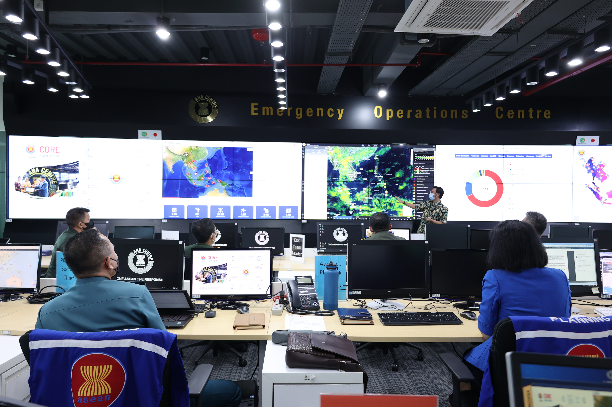

AHA CENTRE ROLE & MECHANISM

Slide 2
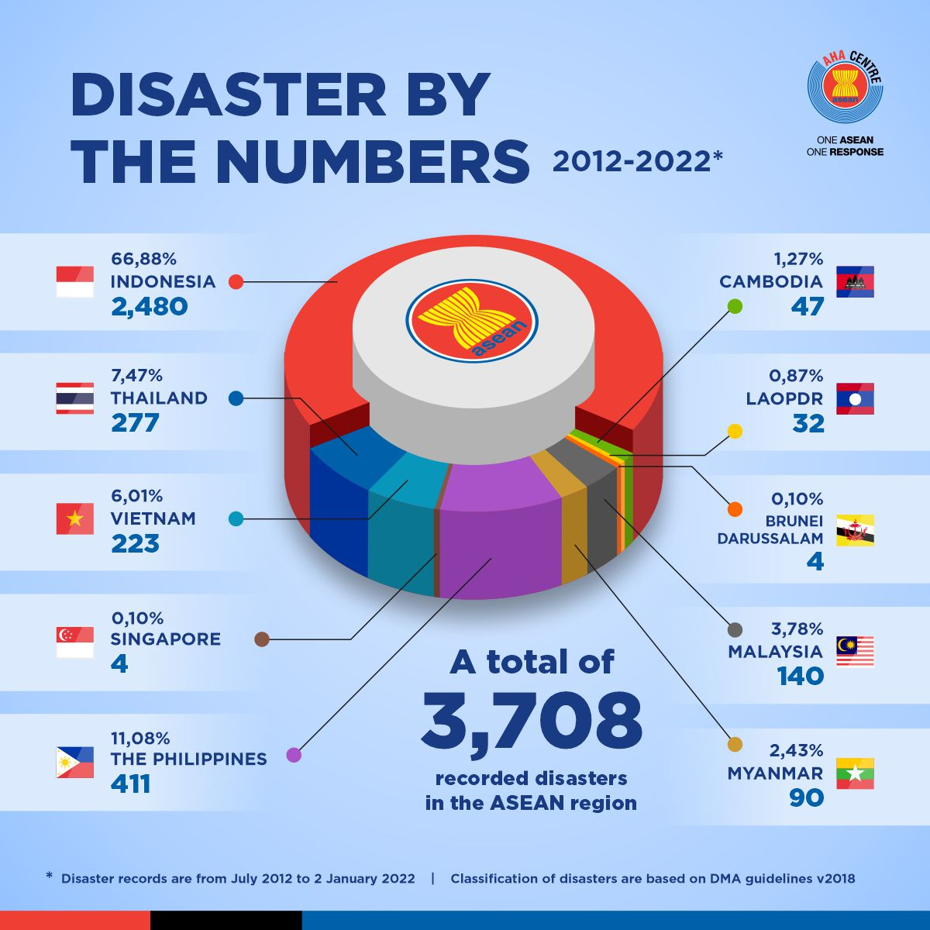



The ASEAN region has been the host of “world class disasters“ in the past decades …
2004 Indian Ocean Tsunami (affecting Indonesia, Malaysia, Thailand and Myanmar)
2008 Cyclone Nargis in Myanmar
2013 Typhoon Haiyan in the Philippines
Combined damage costs from these disasters are estimated at a staggering USD22.5 billion, with 278,000 fatalities

Slide 3
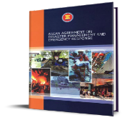
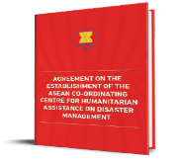


The AHA Centre has a strong mandate as the regional operational coordination engine, given through two legally-binding agreements ratified by all the ten ASEAN countries …..
The ASEAN Co-ordinating Centre for Humanitarian Assistance on disaster management (AHA Centre) shall be established for the purpose of facilitating co-operation and co-ordination among the Parties, and with relevant United Nations and international organisations, in promoting regional collaboration.
(Article 20, ASEAN Agreement on Disaster Management & Emergency Response)
The purpose of the AHA Centre is to facilitate co-operation and co-ordination among the Parties, and with relevant United Nations and international organisations, in promoting regional collaboration in disaster management and emergency response.
(Article 3, Agreement on the Establishment of the AHA Centre)
Notes:
Additional One ASEAN One Response

Slide 4
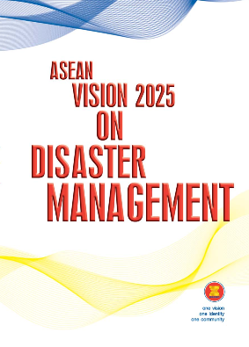
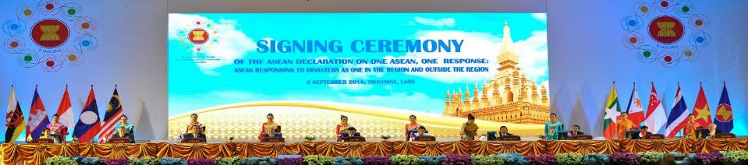
…. as well as high-level direction from the ASEAN Ministers in charge of Disaster Management, and the ASEAN Leaders (Heads of State/Government) ….
ASEAN is well placed to become a global leader given its vast experience, knowledge and expertise in disaster management and emergency response by 2025... However, this current focus of the AHA Centre may need to be expanded in the next ten years …
(ASEAN Vision 2025 on Disaster Management)
Affirm that the AHA Centre is the primary ASEAN regional coordinating agency on disaster management and emergency response
AHA Centre, at a later stage, to enable ASEAN to respond to disasters outside the region, where appropriate, in partnership with regional and international agencies and centres …..
(ASEAN Declaration on One ASEAN One Response)

Slide 5
















The AHA Centre reports directly to the ten National Disaster Management Organisations of ASEAN Member States
BRUNEI DARUSSALAM
National Disaster Management Centre
MYANMAR
Department of Disaster Management
CAMBODIA
National Committee for Disaster Management
PHILIPPINES
National Disaster Risk Reduction and Management Council
INDONESIA
National Disaster Management Authority
SINGAPORE
Singapore Civil Defence Force
LAO PDR
National Disaster Management Office Department of Social Welfare
THAILAND
Department of Disaster Prevention and Mitigation
MALAYSIA
National Disaster Management Agency
VIET NAM
Viet Nam Disaster Management Authority, MARD - CCNDPC
The ASEAN SECRETARIAT as the Secretariat to the ACDM and ex-oficio member of the Governing Board of the AHA Centre
In the event of large-scale natural disasters, the Secretary-General of ASEAN as ASEAN Humanitarian Assistance Coordinator and the AHA Centre will establish coordination lines
Notes:
Replace logo and flags

Slide 6
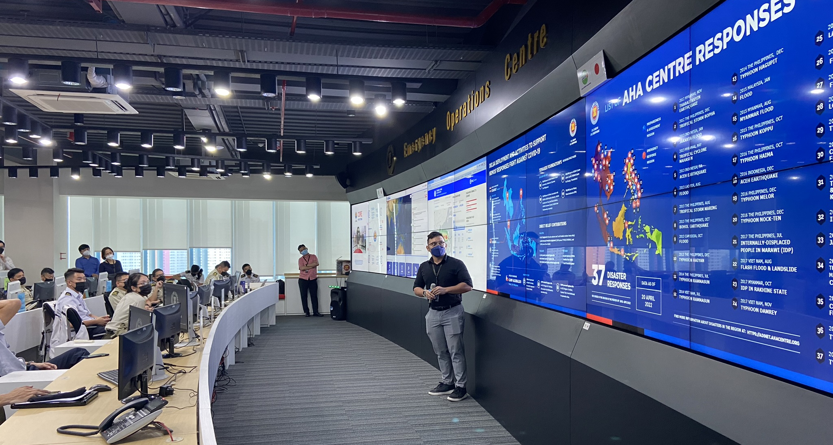
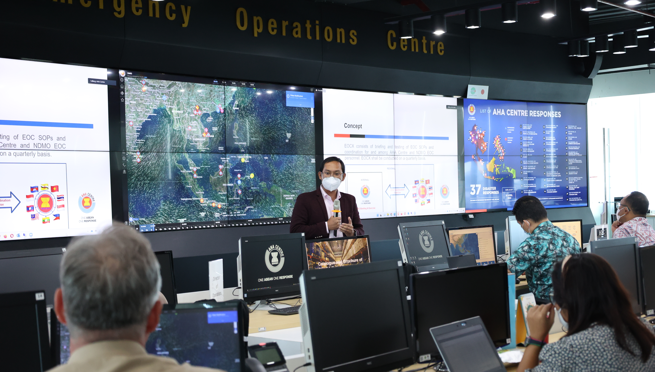
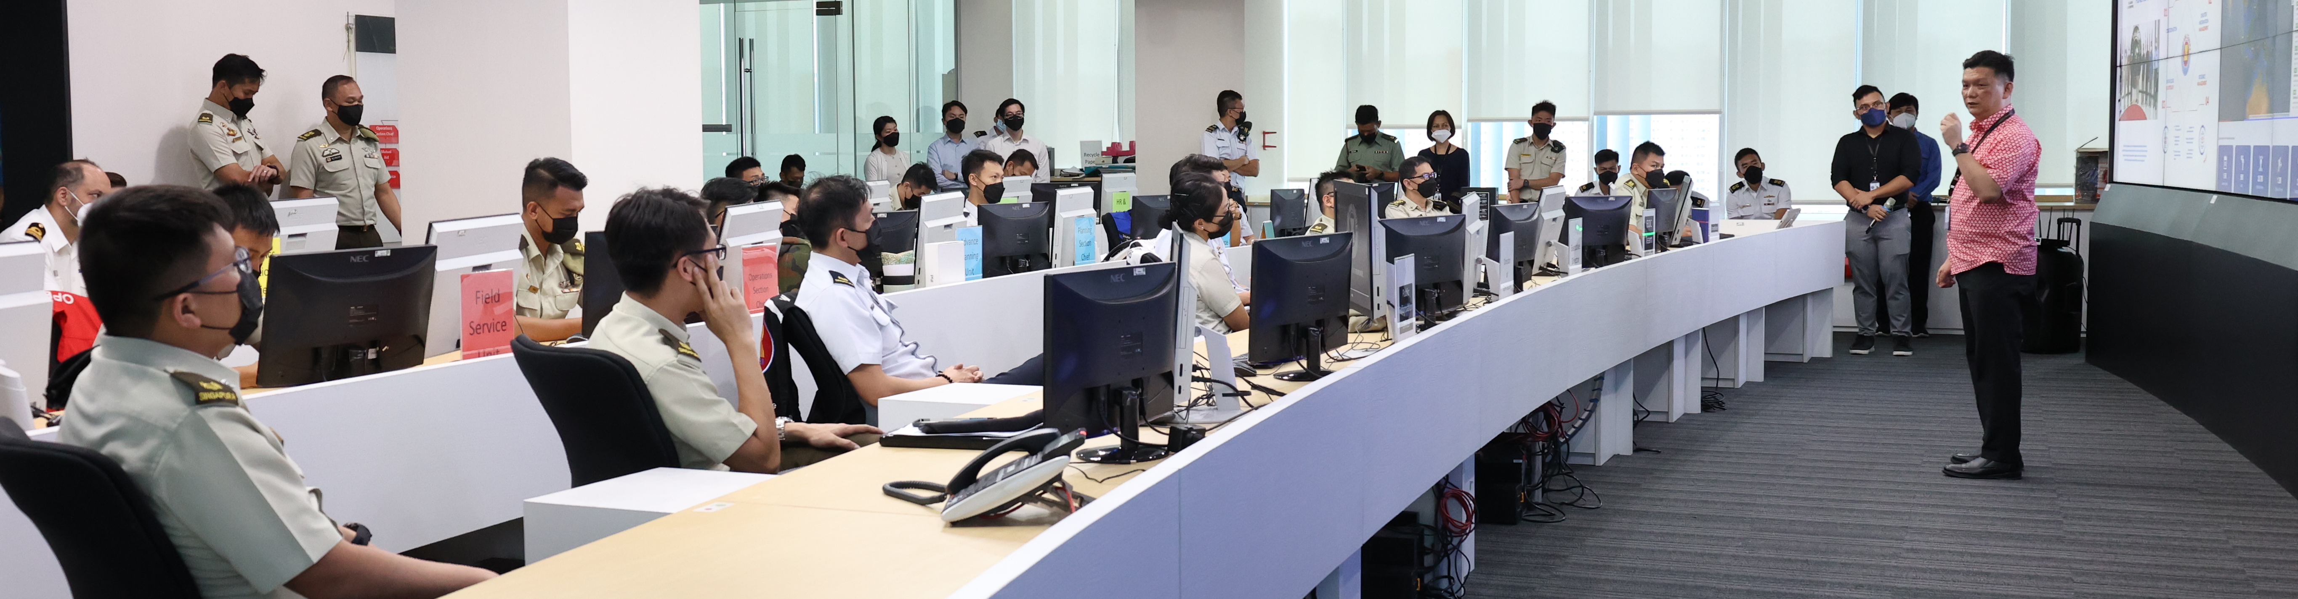

The AHA Centre is the primary ASEAN regional coordinating on disaster management and emergency response. Our office also houses the Emergency Operations Centre (EOC), which serves as the central location in monitoring disasters and coordinating ASEAN’s response to disasters

Slide 7
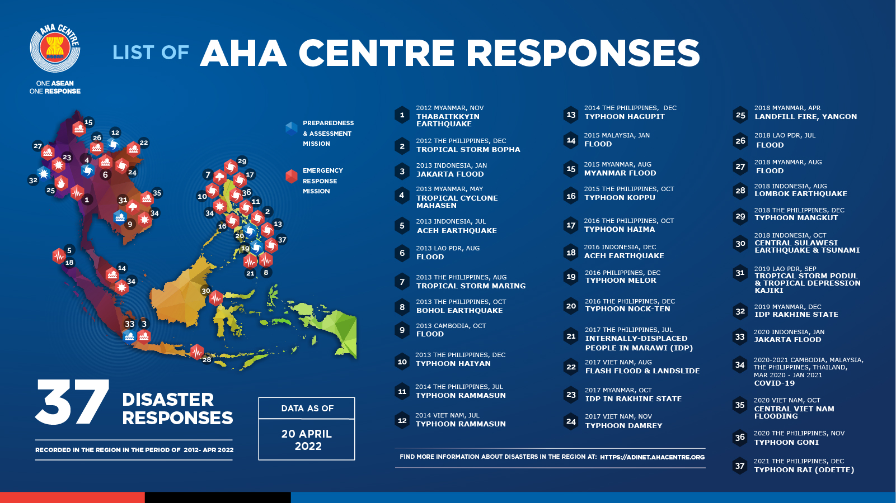

Slide 8
Some lessons and opportunities from responding to disasters with the context of COVID-19
Medium Disaster
Large Disaster
Catastrophic Disaster
As local as possible when capacity is available, support as needed
Remote support such as analysis
Focus on more on preparedness & anticipatory actions
Build on in-country networks, partnerships resources
Have an agreed finish line for capacity building support – creating resilience not reliance
Ability to be flexible and agile is needed
SCALABLE
APPROACH

Slide 9


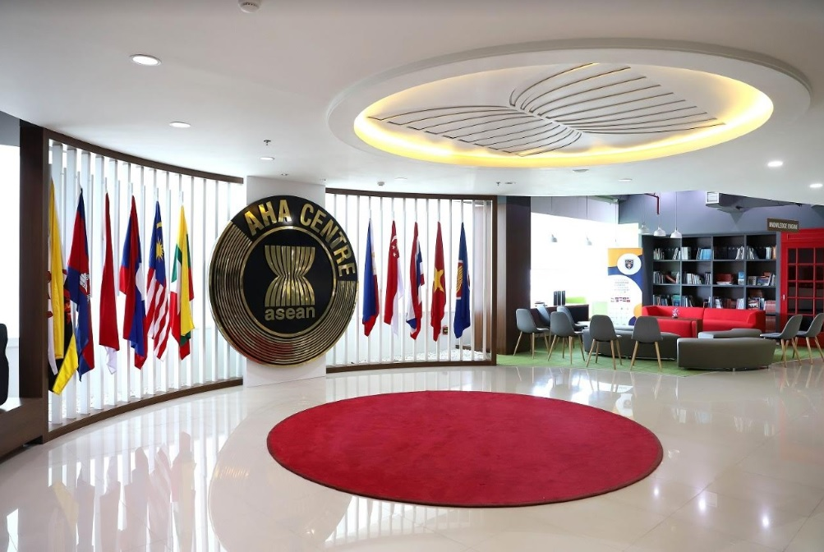
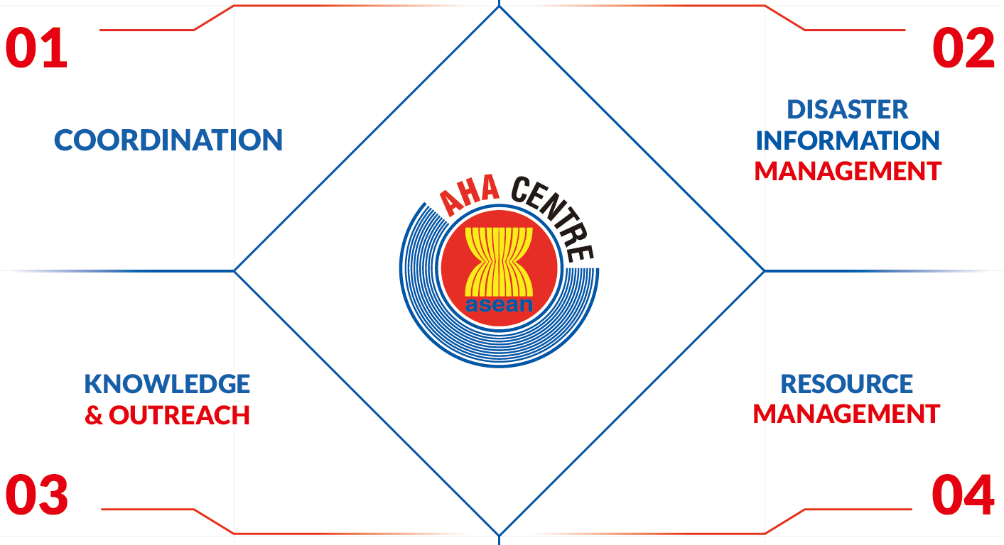


Slide 10
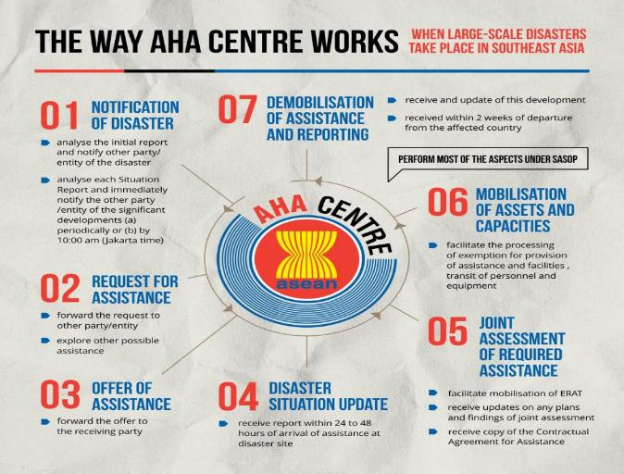
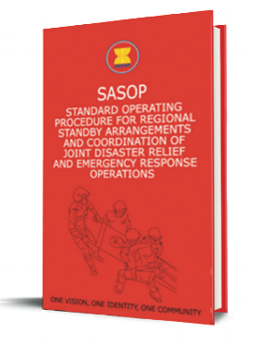


Slide 11




DISASTER INFORMATION MANAGEMENT
24/7 Hazard and Disaster Monitoring
for disaster preparedness and response
Risk Assessment and Analysis of Disaster Risk Levels and maintaining communication linkages with national disaster management offices and partner agencies
Reports and internal/external updates to support overall emergency response operations
Implementation of Activities to attain objectives in relation to the ASEAN work programmes and AHA Centre work plans

Slide 12


WORK FLOW
DURING PEACETIME OPERATIONS
WORKFLOW
DURING EMERGENCY OPERATIONS
4
1
Monitoring
4
1
Monitoring
Recording
Publications
News, Social Media, NDMOs & Reports from disaster related agencies, Reports from Humanitarian and Developmental Organisation Partners, Scientific Papers
ARMOR Publication -
ASDMP Repository-
News, Social Media, NDMOs & Reports from disaster related agencies, Reports from Humanitarian and Developmental Organisation Partners, Scientific Papers
ADINet -
ReliefWeb/GDACS -
Humanitarian Data - Exchange (HDX)
2
3
2
Risk Assessment and Analysis
3
Recording & Updating
Updating and Notification
Information Products
- ASEAN Disaster Information Network (ADINet)
- ASEAN Disaster Monitoring and Response System (DMRS)
Flash/Situation Updates -
Flash Alerts -
- In-country liaison team (ICLT) and Emergency Response and Assessment Team (ERAT)
- Disaster Monitoring and Response System (DMRS)
- WebEOC (Web Emergency Operation Centre)
Flash/Situation Updates -
Flash Alerts -
Notes:
remove

Slide 13
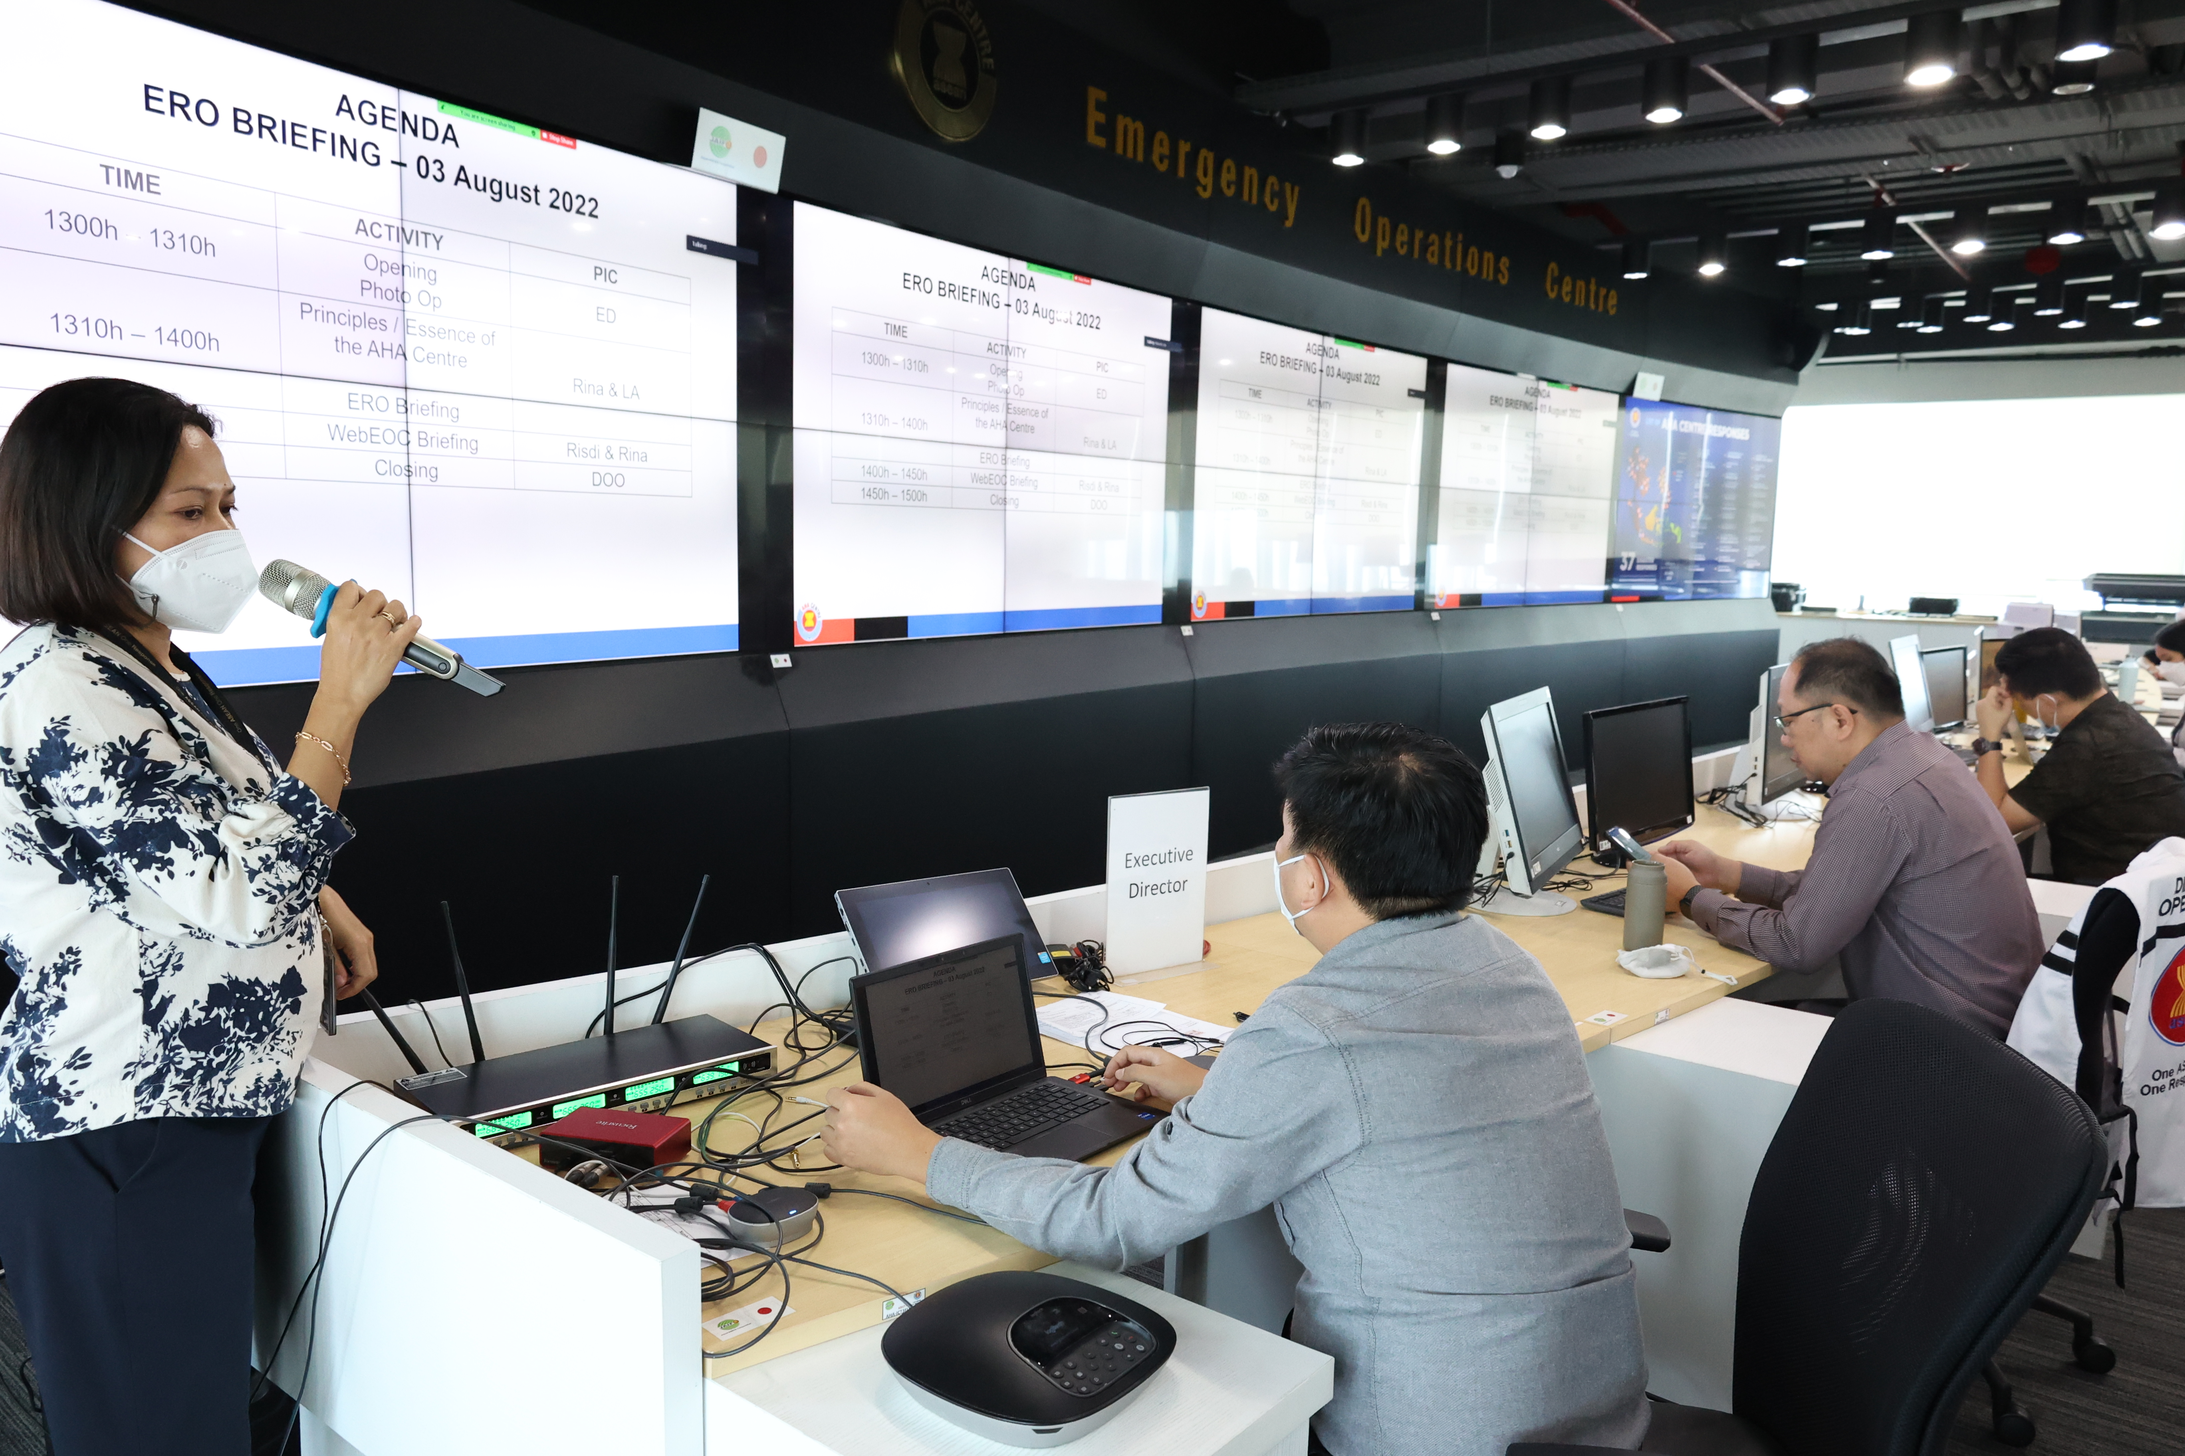
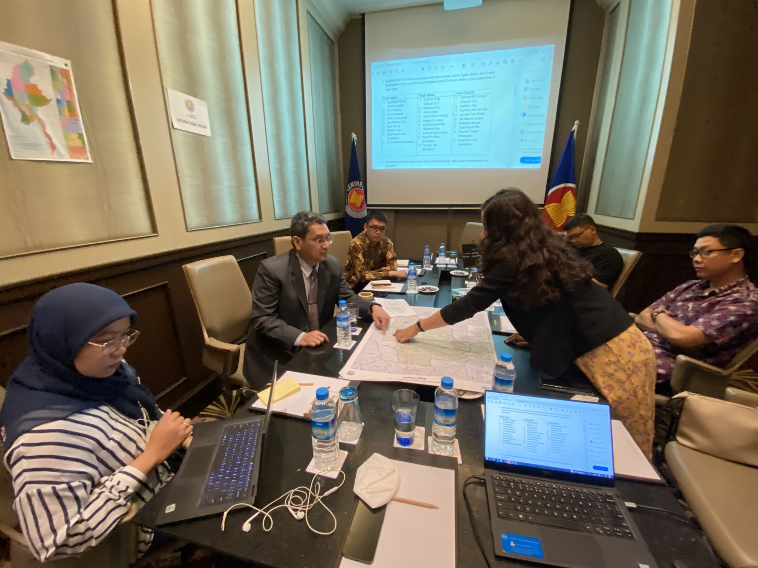
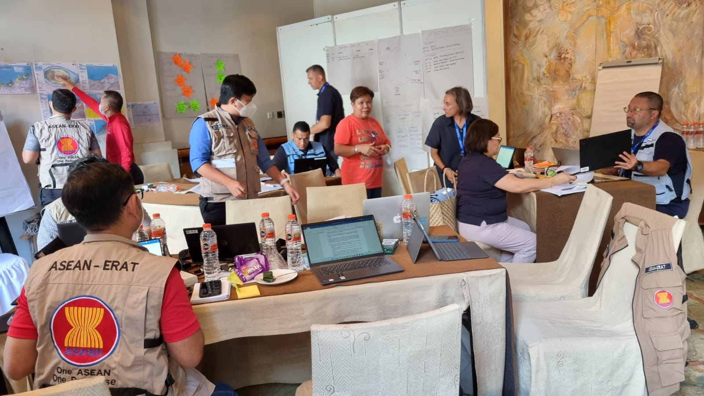
In times of emergencies, the AHA Centre will establish coordination at three levels:
Strategic coordination: Briefing and information sharing for a common operational picture will be organised at the AHA Centre EOC (Jakarta).
High level stakeholders: ASEAN Secretary-General, Permanent Missions to ASEAN, Defence Attaches, heads of other ASEAN entities, heads of UN organisations, Red Cross & Red Crescent Movement, civil society, private sector.
Strategic
Operational coordination: Coordination is established at the national level for joint planning with empahasis on the primary role of the affected country’s National Disaster Management Organisation (NDMO).
Operational
Field coodination: The AHA Centre deploys coordination tools e.g. the ASEAN-Emergency Response and Assessment Team (ERAT), and the Joint Operations and Coordination Centre of ASEAN (JOCCA). The JOCCA or the home of ASEAN on the ground, should be co-located with the NDMO of the affected country.
Field

Slide 14
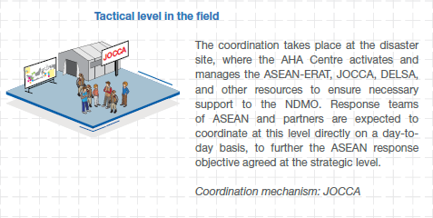

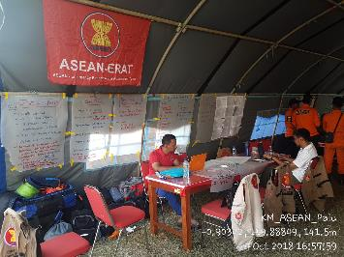
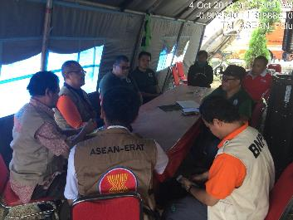
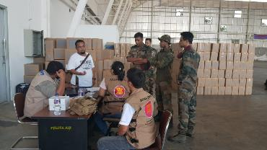
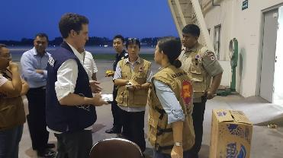
The AHA Centre provided field coordination support for post Central Sulawesi earthquake & tsunami
Palu, Central Sulawesi | Balikpapan, East Kalimantan
Joint Operations & Coordination Centre for International Assistance (JOCCIA) setup co-locate with BNPB’s National Assisting Post (Pospenas) Registration desk for incoming international teams & relief items Facilitation on coordinated assessment meeting, data consolidation, and analysis Information hub for situational awareness and emergency response planning | Support to BNPB on facilitating incoming international assistance to the staging area at the Balikpapan International Airport Liaison services between incoming international teams with BNPB, Customs, Immigration, and Airport Authority (CIQP facilities) Moving forward: Coordination setup w/ military (CMcoord) and operationalisation of the ASEAN Military Ready Group (AMRG)
Coordination
Notes:
Integrated-asean mechanism and recovery.

Slide 15
2018 Central Sulawesi Response marked the first time the AHA Centre supporting coordination of incoming international assistance – a role that may be repeated in the future
Notes:
remove

Slide 16
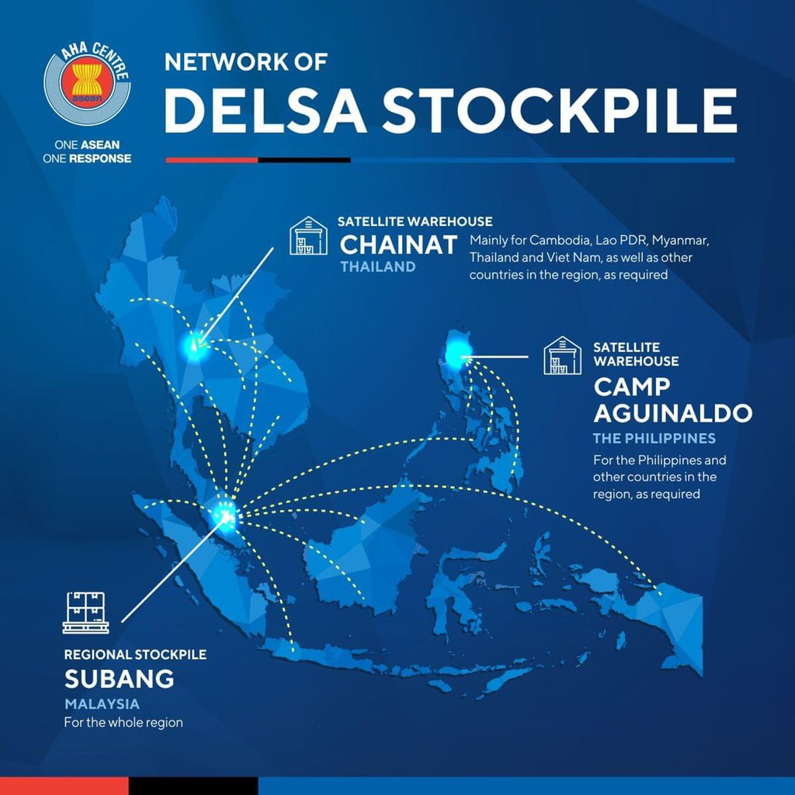
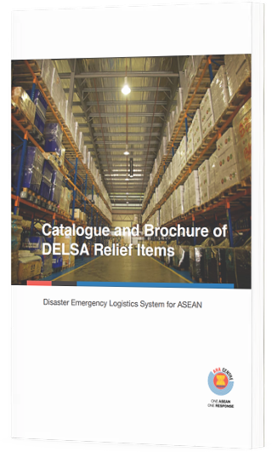

Slide 17
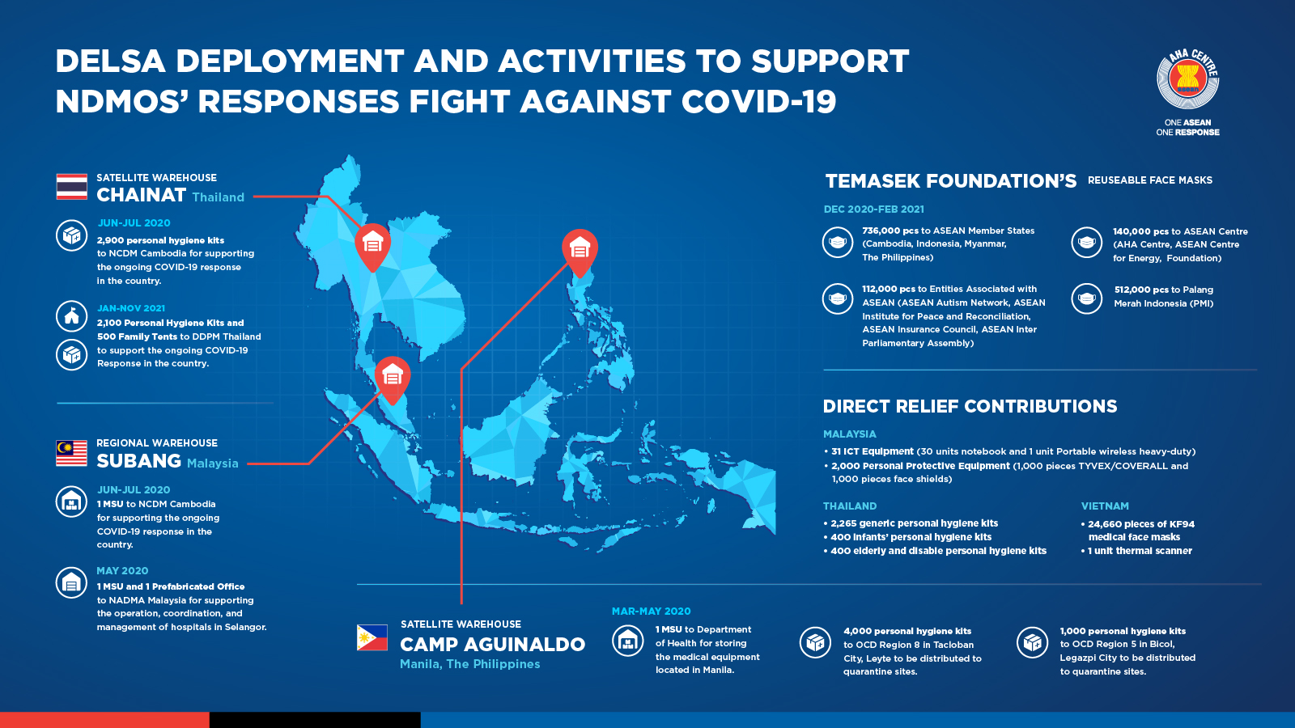

Slide 18
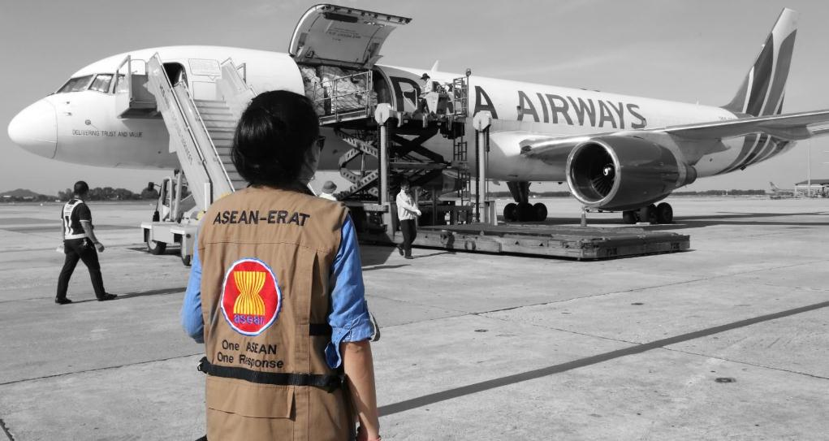
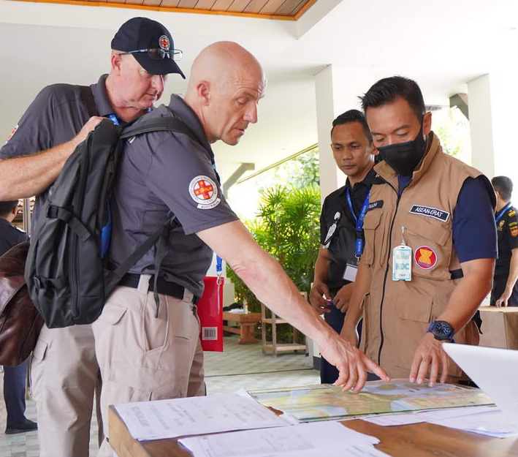
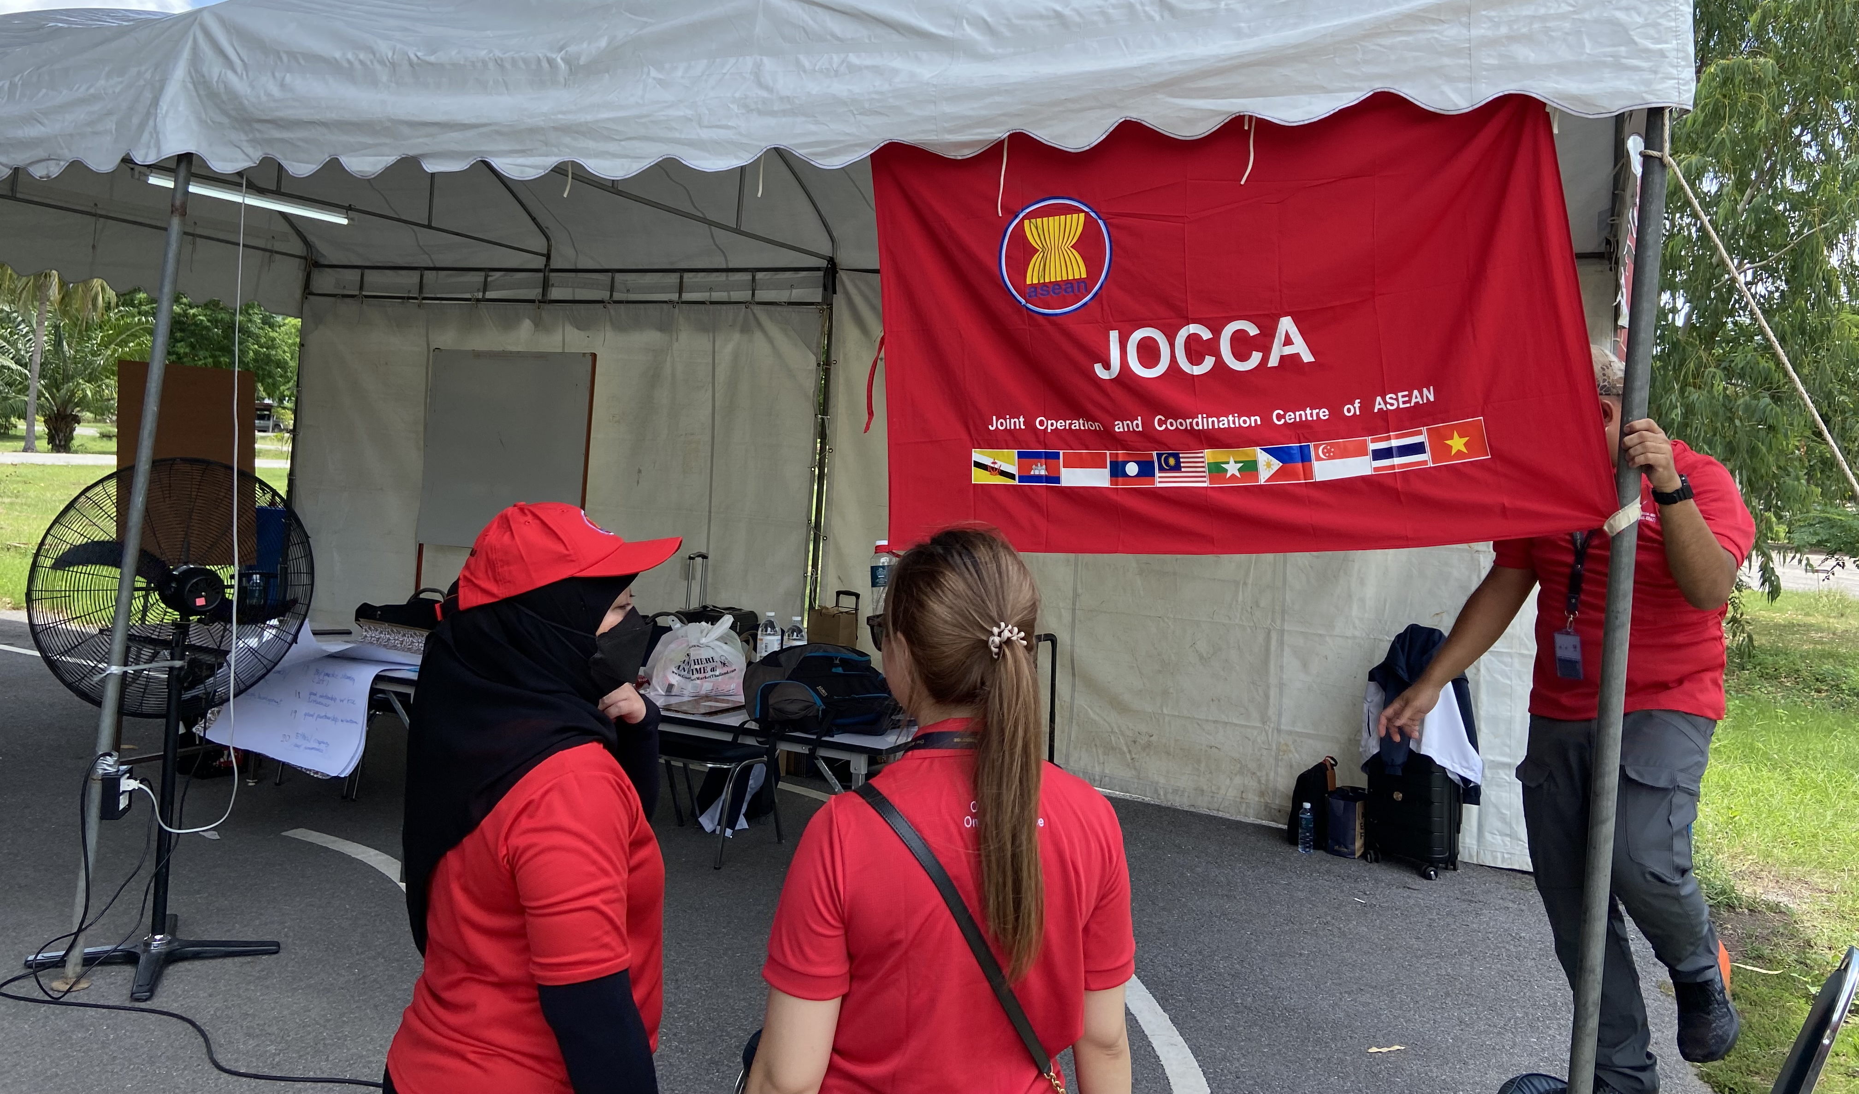
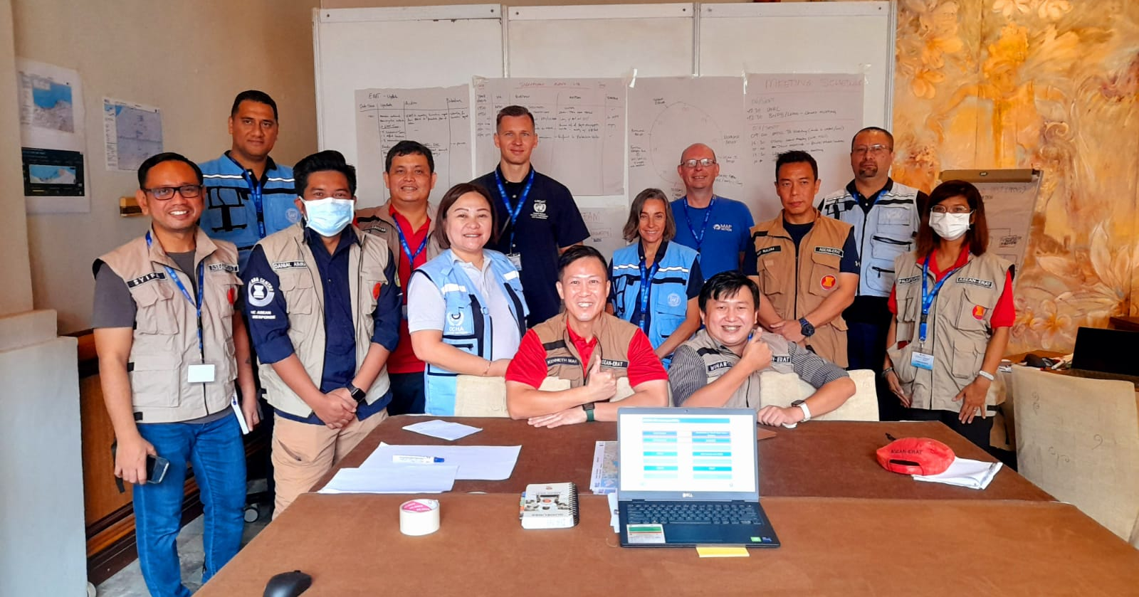
The AHA Centre is also managing the ASEAN-ERAT that can be deployed as
a regional response team
Regional rapid response team;
Deployed upon request – free of charge;
In support of the National Disaster Management Organisation;
Currently over 350 in the roster, and will grow more & go bigger in-country;
Immediate deployment - within 24h arrive in the affected country;
Fully self-sufficient;
Set-up a Joint On-Site Operations and Coordination Centre (JOCCA);
Coordination, rapid assessment, logistic support, early recovery, civil-military coordination;
Deployed for approximately 10-14 days;

Slide 19
The ASEAN Agreement on Disaster Management and Emergency Response (AADMER) clearly articulates utilisation of military capabilities, such as under Preparedness (Article 8.2.b) and the ASEAN Standby Arrangements for Disaster Relief and Emergency Response (Article 9.1.b)
The ASEAN Standard Operating Procedures for Regional Standby Arrangements and Coordination of Joint Disaster Relief and Emergency Response Operations (SASOP) provides the guides, procedures and templates for facilitation and utilisation of civilian and military capabilities for disaster relief and emergency operations
The ASEAN Declaration on One ASEAN One Response, signed by the ASEAN Leaders on 6 September 2016 in Vientiane, confirms that ASEAN SASOP as a protocol under AADMER is the main standard operating procedure to be used for mobilisation of both civilian and military capabilities in materialising One ASEAN One Response
Notes:
Utilisation of military capabilities is clearly articulated in AADMER and OAOR Declaration

Slide 20
One ASEAN One Response is about ASEAN responding to disasters in the region and outside the region as ONE i.e. having as many relevant stakeholders as possible, including military, to achieve the envisioned speed, scale and solidarity
SASOP Chapter VI as well as AMRG on HADR contribute to:
  increasing the speed,
  expanding the scale, and
  enhancing the solidarity
for ASEAN collective response to disasters
Notes:
Bagaimana Chapter VI dan AMRG SOP berkontribusi kepada collective response for OAOR. Berterima kasih kepada military, ADMM atas kontribusinya untuk meningkatkan speed scale solidarity

Slide 21
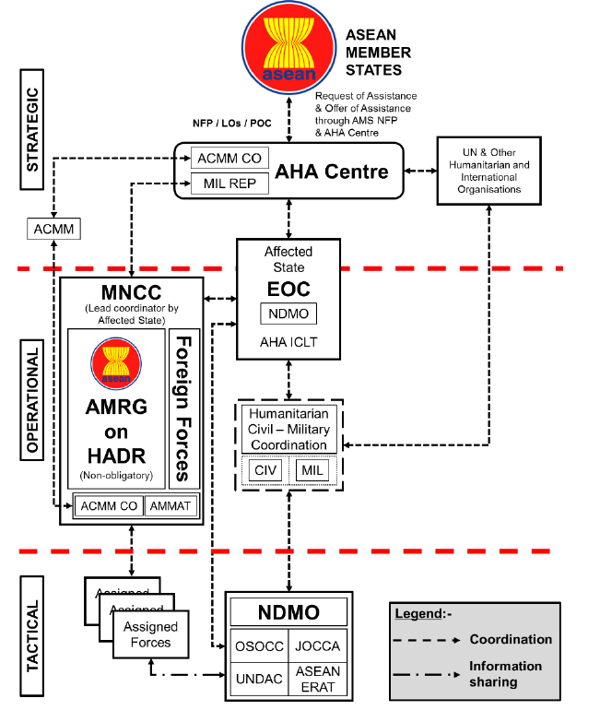
Recommendations for the ACMM to connect with the AHA Centre on HADR operations:
Follow ASEAN SASOP for processing offers and requests of assistance. This is in line with the seven principles in operationalising OAOR:
  One policy framework: AADMER,
  One SOP: SASOP,
  One response plan: AJDRP,
  One policy body: ACDM,
  One point of contact: NDMOs,
  One regional coordinating agency: AHA Centre,
  One field coordination centre: JOCCA.
Utilise AMRG on HADR SOP as the umbrella for mobilising ACMM capabilities. ACMM can serve as one of the resources under AMRG on HADR as shown in the Coordination Mechanism (page 23) of AMRG on HADR SOP.
Notes:
OK put the source and make it bigger –
This can be a suggestion for the ACMM to connect with the AHA Centre. Our recommendations:
Stick to SASOP for offers and requests of assistance on HADR. And that means formally – utlise NFPs of AADMER. This is in line with the seven principles of OAOR – One policy framework: AADMER, One SOP: SASOP, One response plan: AJDRP, One policy body: ACDM, One point of contact: NDMOs, One regional coordinating agency: AHA Centre, One field coordination centre: JOCCA (see Operationalising OAOR book)
ACMM can be one of the resources under AMRG

Slide 22
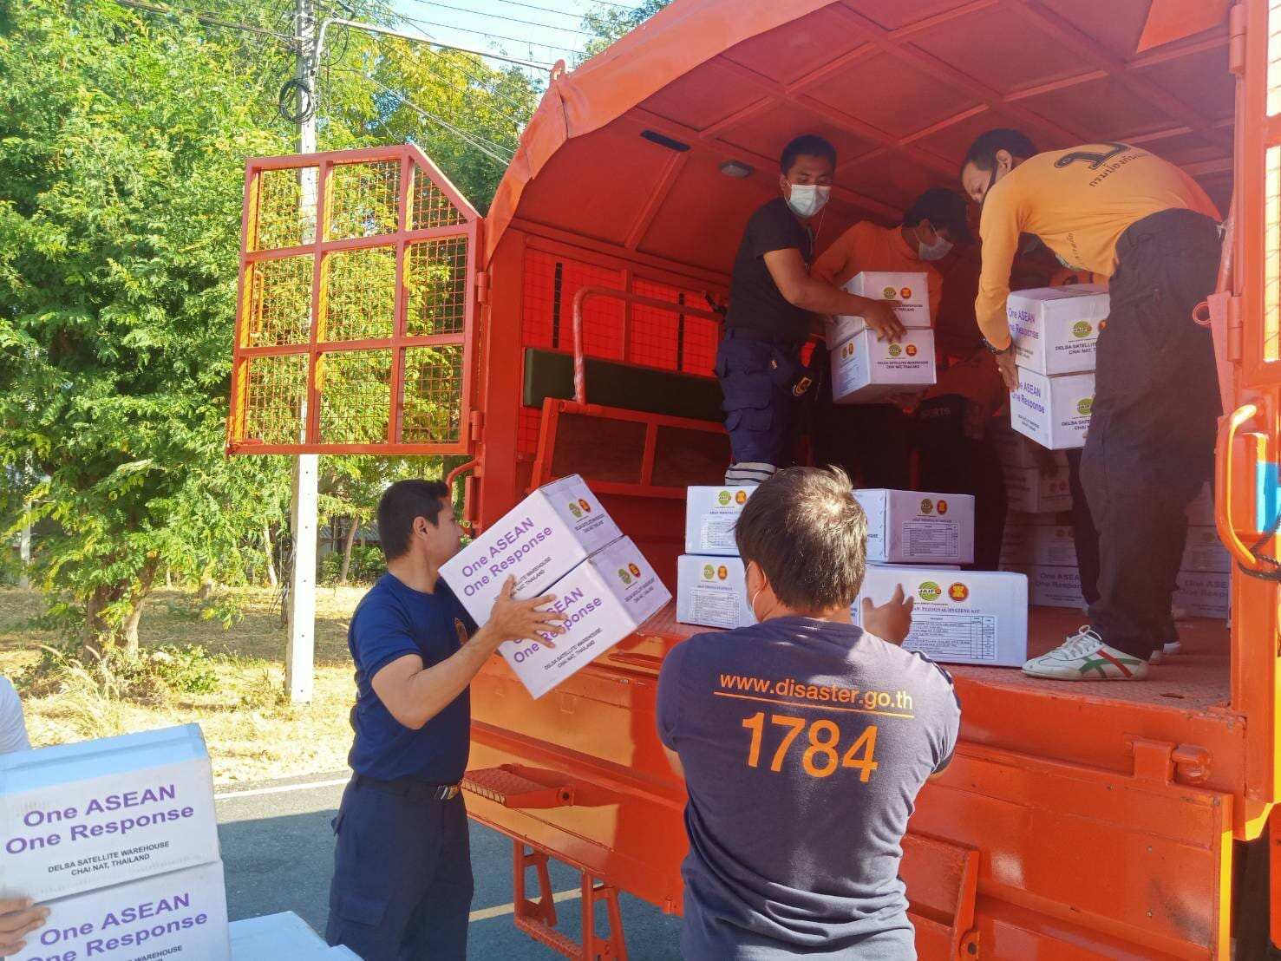
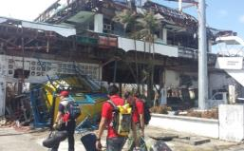
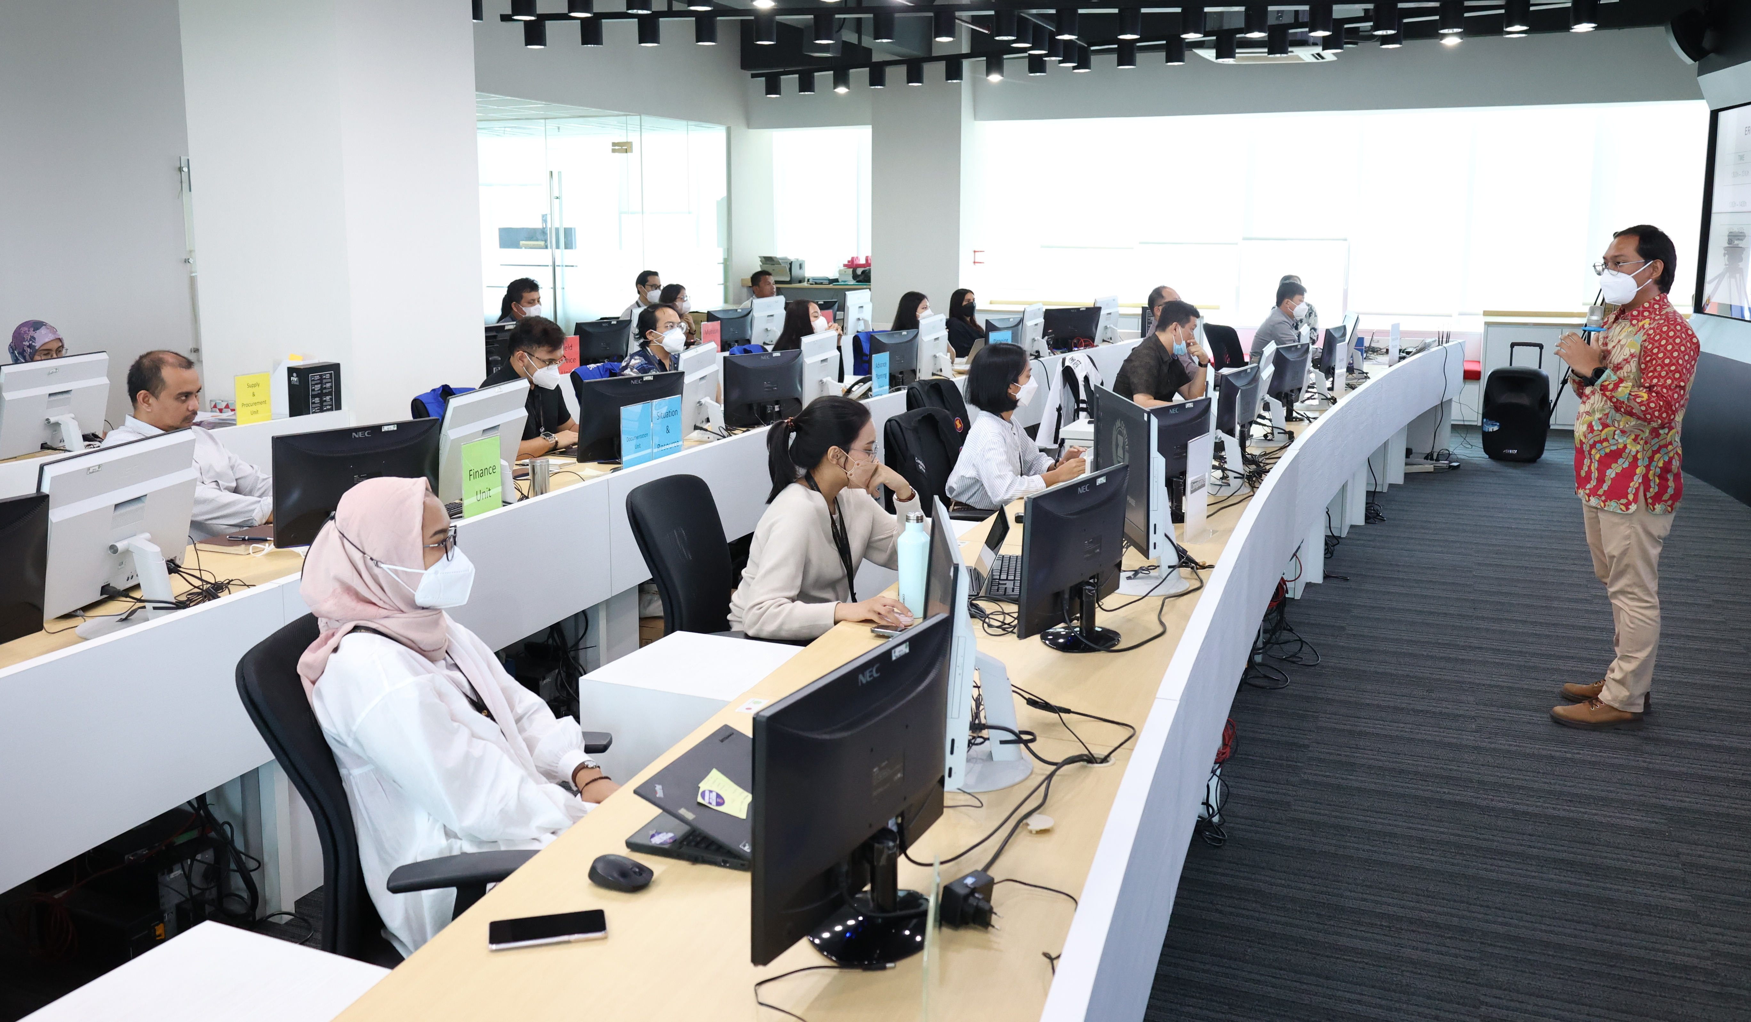
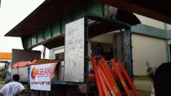

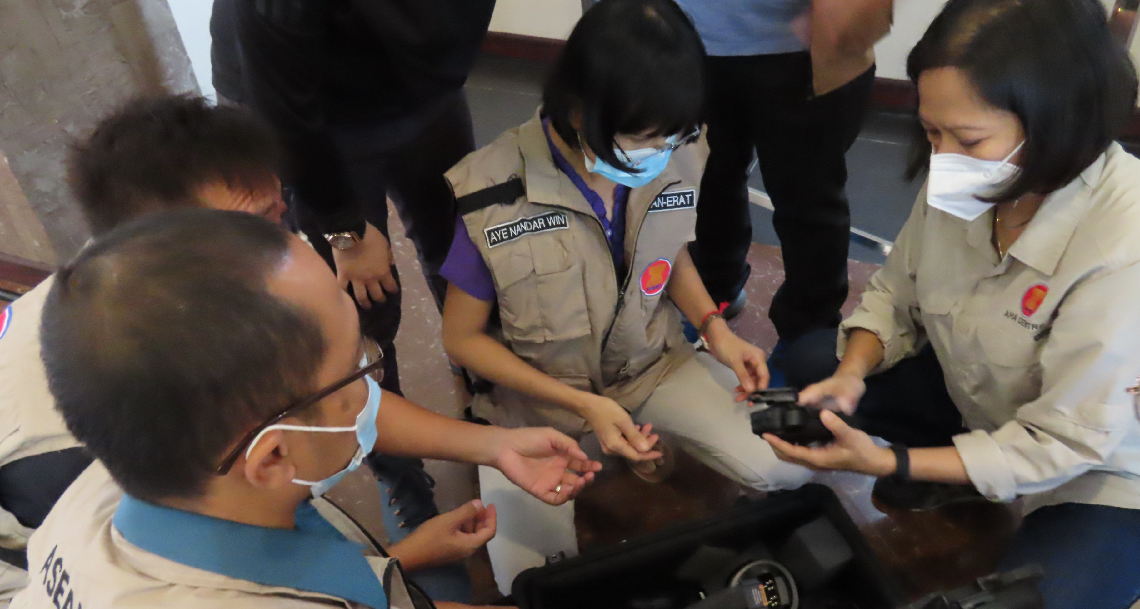
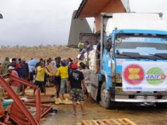
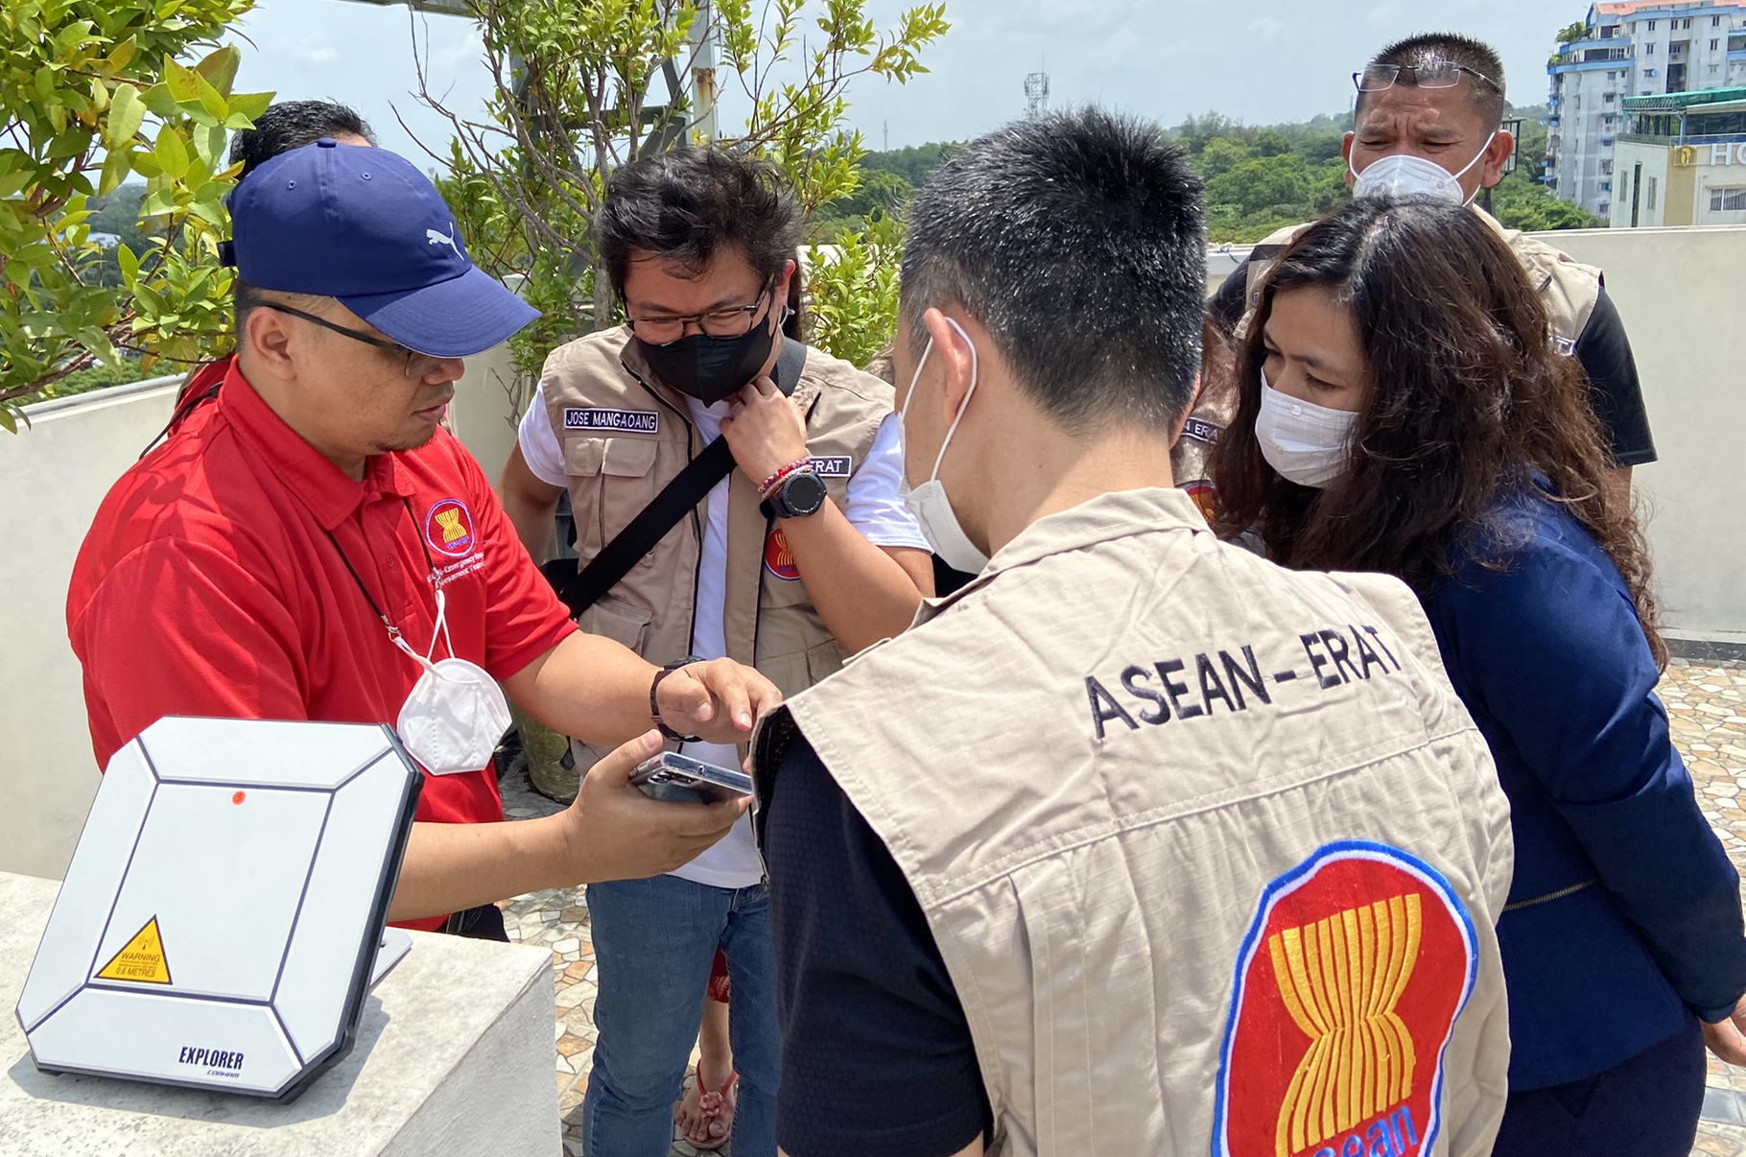
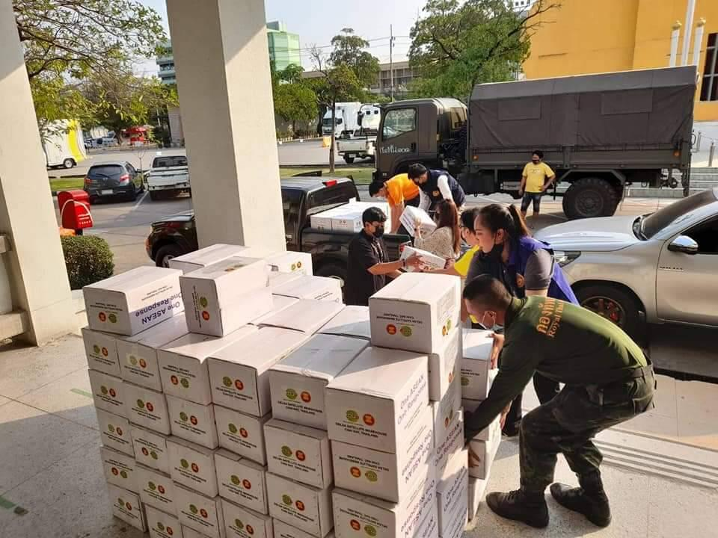
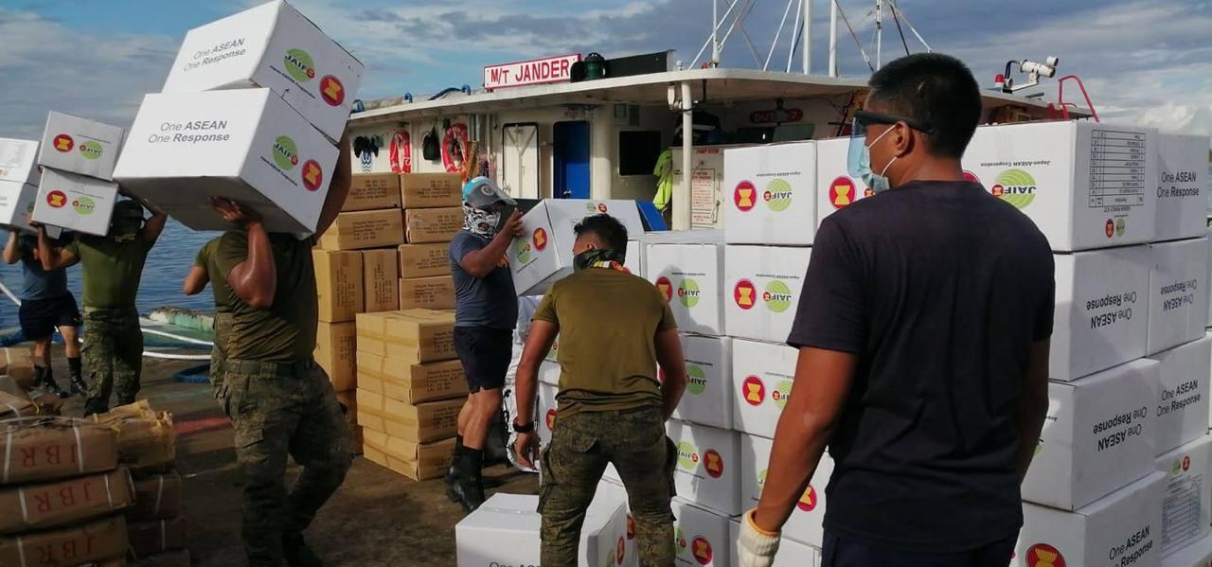
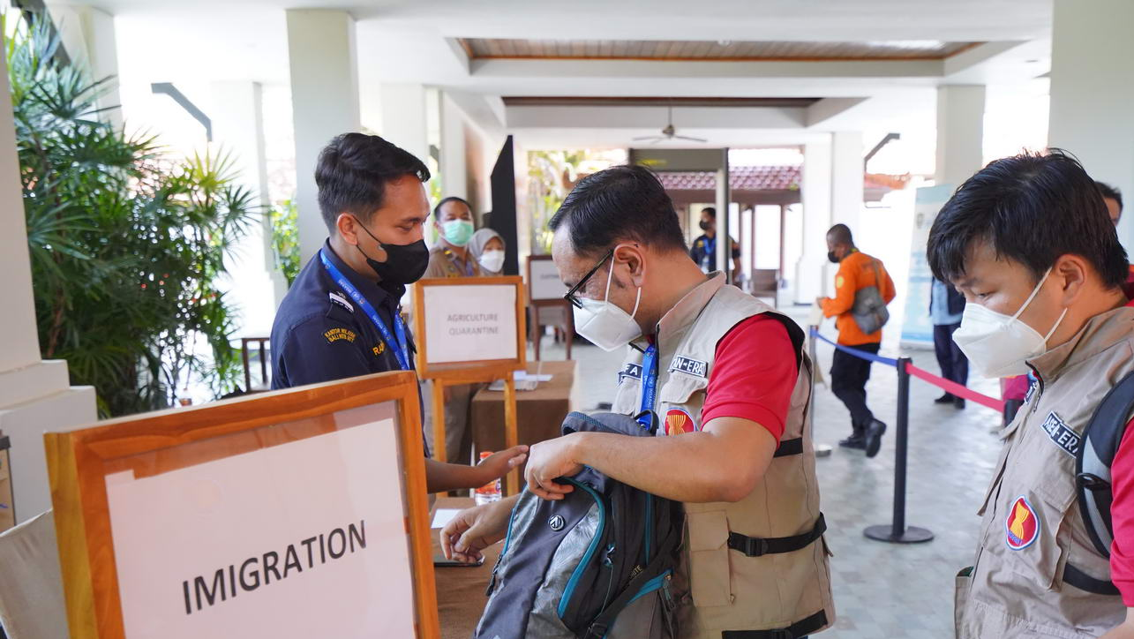
THANK YOU

